Slide 1
The magic bullet:
Bullet Journaling for Increased Productivity
Linda Hofschire | Library Research Service
Colorado State Library | www.lrs.org | @lrs_co

Slide 2
Today’s plan
Bullet Journaling: Why and How
Productivity
  How to exploit our natural tendencies to maximize productivity
  Crowdsourcing tips and tricks

Slide 3
What are 1 or 2 current productivity challenges you’re currently experiencing?

Slide 4
Why bullet journaling?

Slide 5
The Bullet Journal is like a potato. It seems boring and bland and easily replaced by flashier starches like couscous and black forbidden rice, but the potato is special not for what it is but for what it can become…the potato is king simply because it can be whatever you want it to be.
- Kendra Adachi

Slide 6

Inventor of Bullet Hournaling
https://www.youtube.com/watch?v=fm15cmYU0IM
Notes:
https://www.youtube.com/watch?v=fm15cmYU0IM

Slide 7
Bullet journaling – 5 components
Index
Future Log
Monthly Log
Monthly Task List
Daily Log

Slide 8
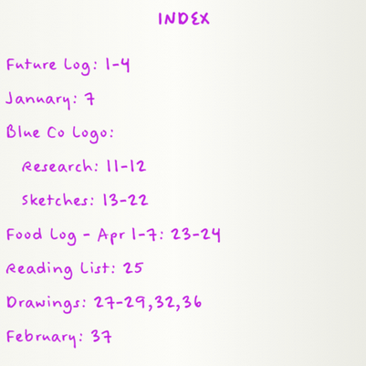
Bullet journaling: Index
Image credit: bulletjournal.com

Slide 9
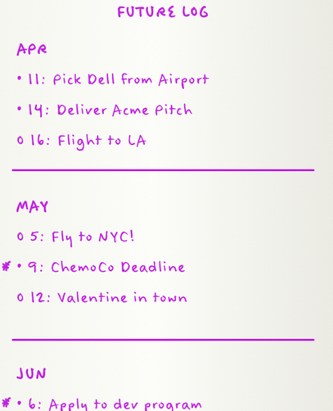
Bullet journaling: future log
Image credit: bulletjournal.com

Slide 10
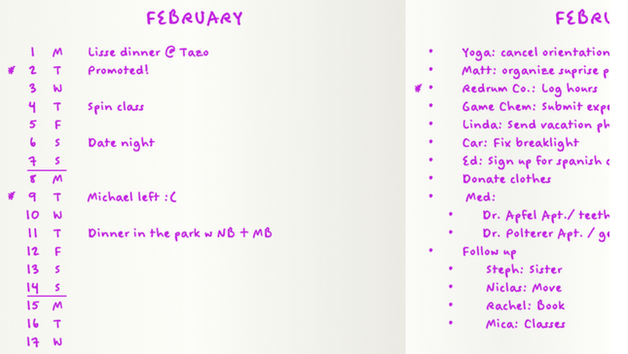
Bullet journaling: Monthly log and task list
Image credit: bulletjournal.com

Slide 11
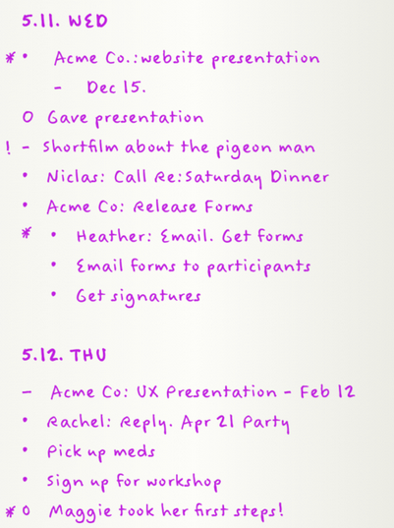
Bullet journaling: daily log
Image credit: bulletjournal.com

Slide 12
Bullet journaling: signifiers
Task
X
Task Complete
>
Task Migrated
–
Notes
Events

Slide 13
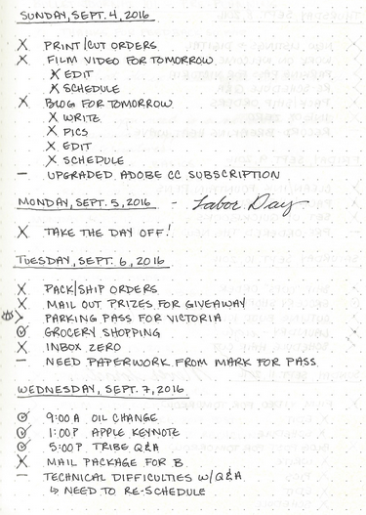
Bullet journaling: Example #1
Image credit: Bringing the Sunshine

Slide 14
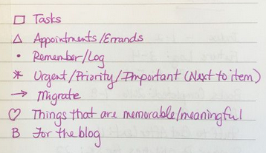
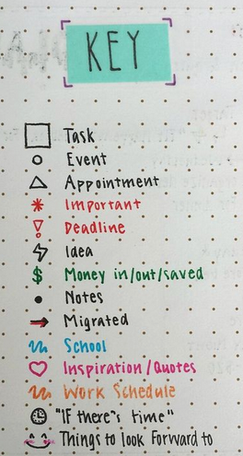
Bullet journaling: Example #2
Image credits: Bringing the Sunshine, DIY Av

Slide 15
Bullet journaling: Collections
Master To-Do List
Current Projects
Ideas for Future Projects
Staff
Goals
Conferences to Attend
Books to Read/Read

Slide 16
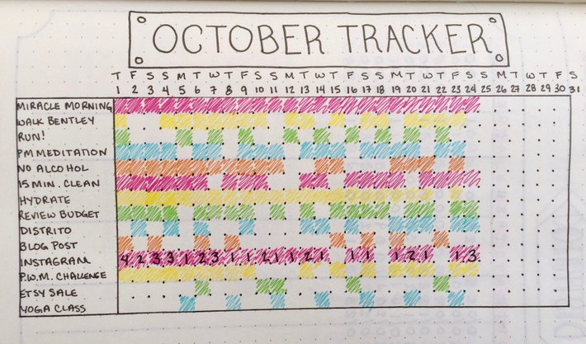
Bullet Journal: Habit tracker
Image credit: Boho Berry

Slide 17
Do you have to be an artist to bullet journal?

Slide 18
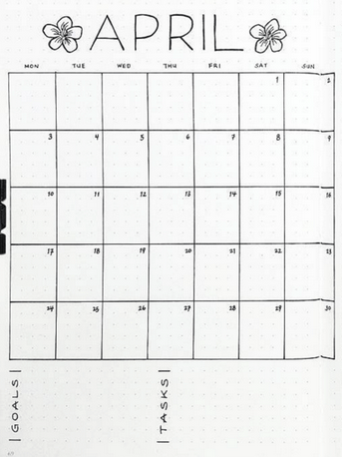
Example #1
Image credit: @journaleying

Slide 19
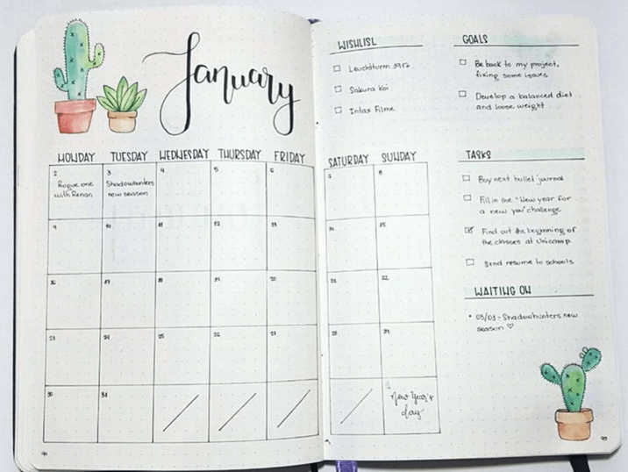
Example # 2
Image credit: @bahcampos

Slide 20
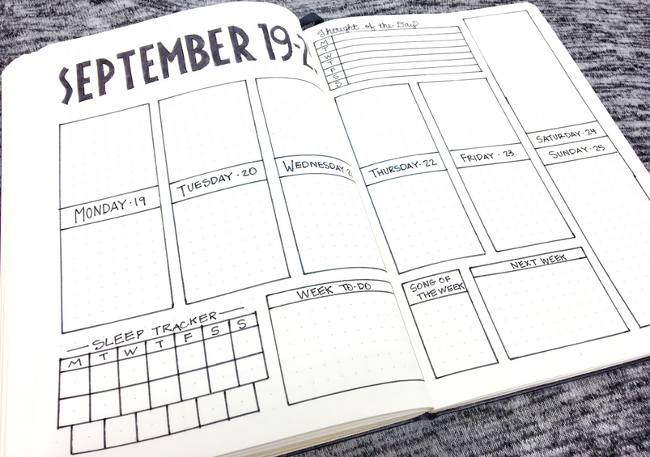
Example # 3
Image credit: @lifebywhitney

Slide 21
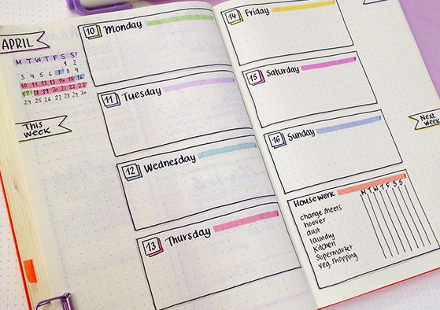
Example # 4
Image credit: @bahcampos

Slide 22
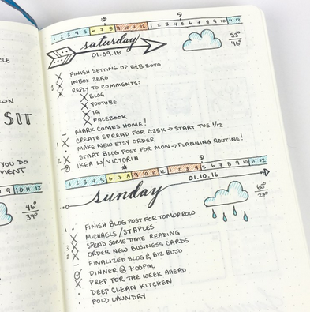
Example # 5
Image credit: Boho Berry

Slide 23
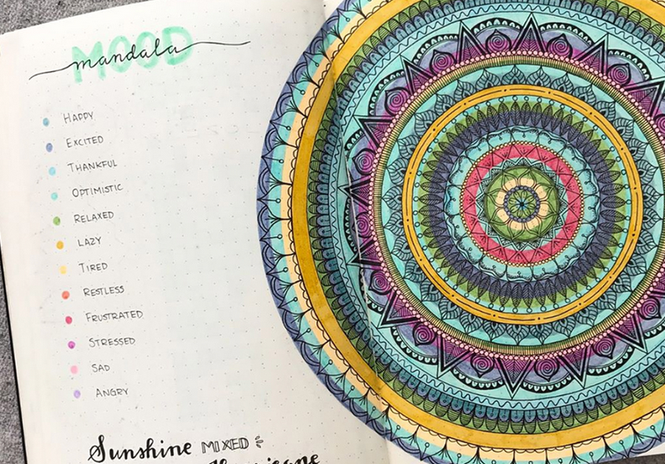
Example # 6
Image credit: bujobeyond

Slide 24
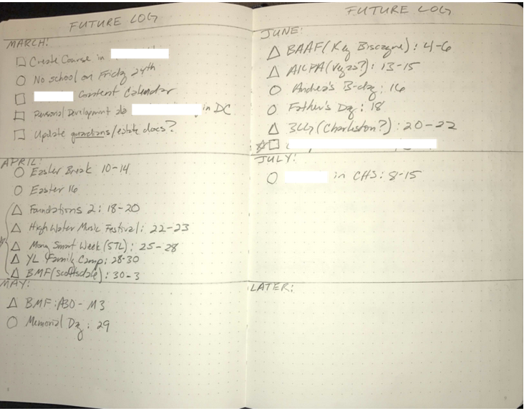
Example # 7
Image credit: Tim Maurer

Slide 25
Making it your own
My system:
  Google Calendar and Outlook Calendar instead of Future Log
  Monthly Log to record major tasks/activities accomplished each day
  Master To-Do List instead of Monthly Task List
  Weekly Log instead of Daily Log, includes to-do list for the week
  Google Keep for quick capture of information on the go

Slide 26
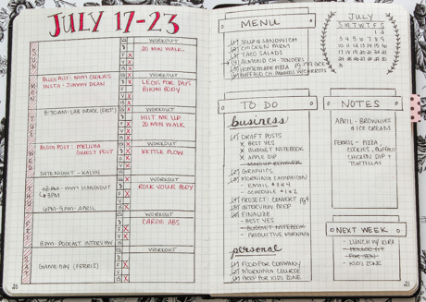
Weekly log
Image credit: Kalyn Brooke

Slide 27
My process
Beginning of Month
  Create monthly log, habit tracker, gratitude log
  Review Projects Collection, Master To-Do List
  Make a decision about unfinished tasks from previous month (migrate, delegate, delete)
  Take photos of previous month’s pages
Beginning of Week
  Create weekly log and to-do list
End of Each Day
  Review notes for action items, add to to-do list
  Check off completed tasks
  Make a decision about remaining tasks (migrate, delegate, delete)
  Complete habit tracker and gratitude log

Slide 28


Bullet journals

Slide 29


Traveler’s notebook

Slide 30
Questions about bullet journaling?

Slide 31
Bullet journalers – share your tips!

Slide 32
productivity

Slide 33

Book Recommendation

Slide 34
How do I respond to outer and inner expectations?

Slide 35
Four Tendencies: expectation Chart
Tendency | Outer Expectations | Inner Expectations
Upholder | Meets | Meets
Questioner | Resists | Meets
Obliger | Meets | Resists
Rebel | Resists | Resists

Slide 36
The four tendencies Examples
Tendency | Description
Upholder | Does what should be done.
Questioner | Does what makes sense to them.
Obliger | Does what others are depending on from them.
Rebel | Does things in their own way.

Slide 37
My tendency: Obliger
Strategy: Set up external systems of accountability
  External deadlines
  Doing presentations with a partner instead of alone
  Taking exercise classes that have a cancellation fee
  Habit Tracker

Slide 38
What helps you be productive?
Technology Tools
Non-Tech Tools
Tips and Tricks
Methods (Getting Things Done, Eisenhower Matrix, Pomodoro, etc.)

Slide 39
Organization quotes
The way to get started is to quit talking and begin doing.
- Walt Disney
The best productivity system is the one you can stick to.
- Thomas Oppong

Slide 40
Thank you!
Linda Hofschire
Library Research Service, Colorado State Library
Hofschire_L@cde.state.co.us
www.lrs.org

