Slide 1
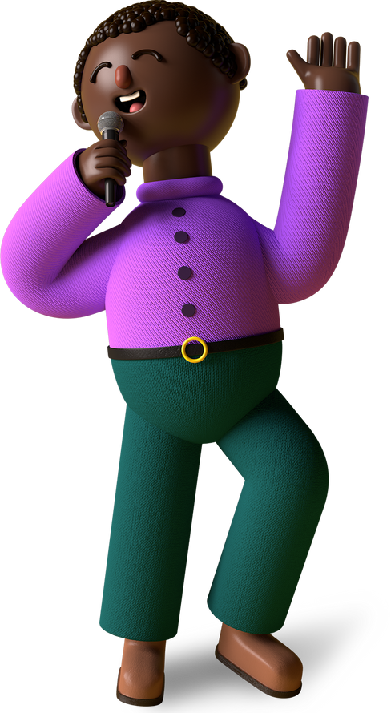
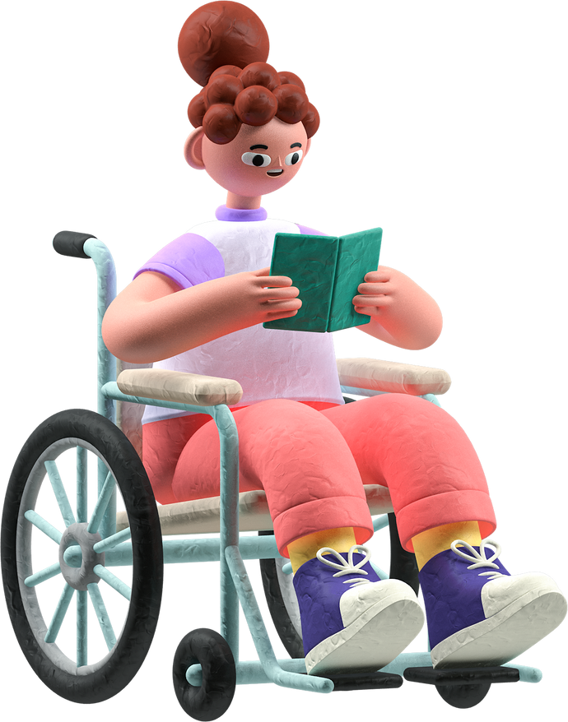
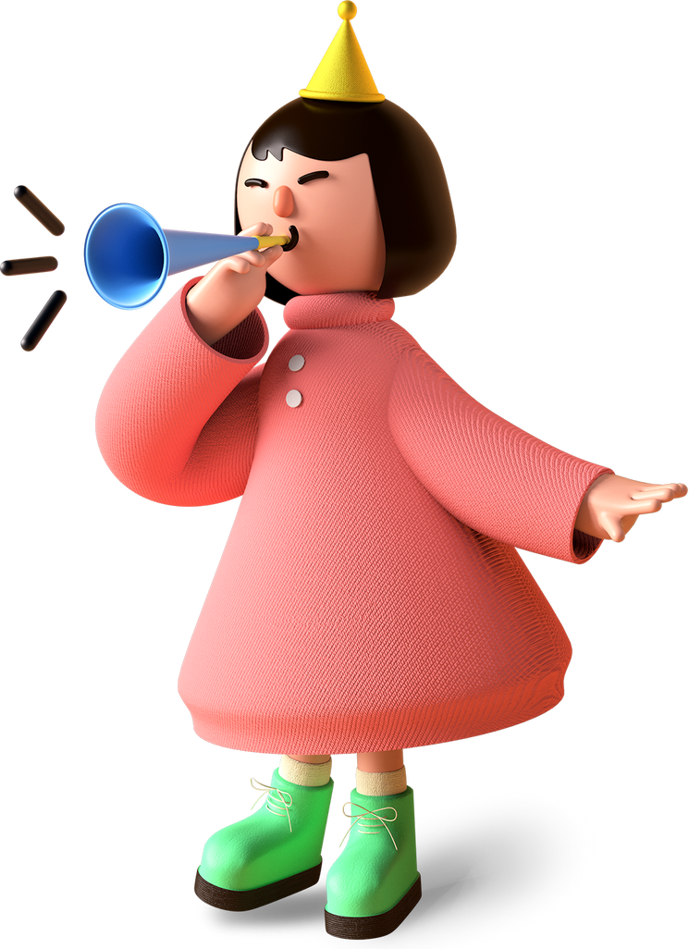

Autism Is Welcome Here
The ACCESS Approach to Inclusion
Presented by Suzi Tonini
tonini_s@cde.state.co.us

Slide 2

Learner Goals
Learn about the unique needs of the autism community.
Learn strategies for creating an autism-friendly library climate.
Learn strategies for sourcing books with authentic and affirming representation of autism.
Learn ideas for designing programming to engage neurodivergent children and teens.
Learn strategies and ideas for serving autistic youth from session participants.

Slide 3
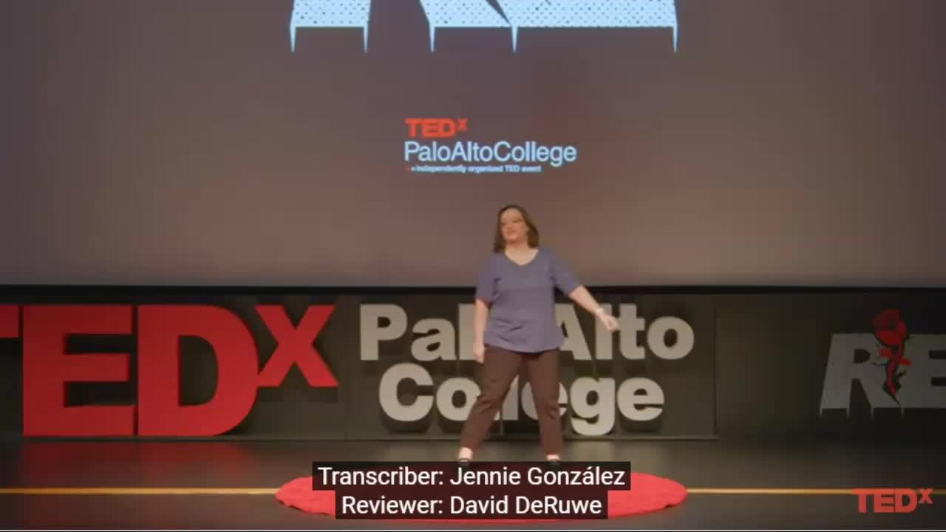
What is autism?
Adriana White, autistic librarian and writer (Adriana's website)
Autism and Neurodiversity: Different Does Not Mean Broken, | TEDxPaloAltoCollege

Slide 4

Audience Poll
What percentage of today’s participants self-identify as autistic,
or have a family member, friend, or coworker who is autistic?

Slide 5

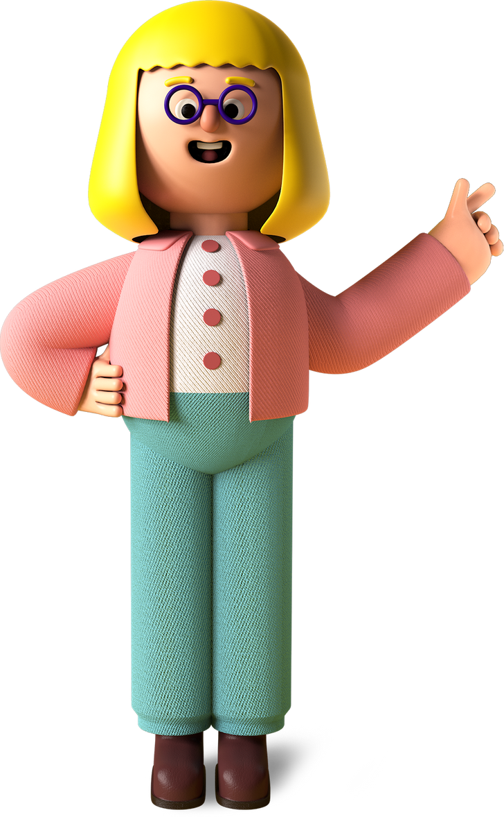
Autism 101
for Librarians
Notes:
.

Slide 6
1 in 36 children are diagnosed with autism (approximately 4% of boys and 1% of girls).
Centers for Disease Control and Prevention

Slide 7
There is a research gap in studies on autism in adulthood.
It is common to miss an ASD diagnosis until later in life.
Autism Society of Oregon

Slide 8
Approximately 1/3 of children with ASD also have an intellectual disability.
Centers for Disease Control and Prevention
Notes:
.

Slide 9
Autism affects all ethnic and socioeconomic groups.
Centers for Disease Control and Prevention

Slide 10
Early intervention affords the best opportunity to support healthy development and deliver benefits across the lifespan.
National Early Childhood Technical Assistance Center

Slide 11
Autistic individuals often experience sensory sensitivity.
Autism Society

Slide 12
Autistic individuals may have greater difficulty shifting attention from one task to another or adapting to changes in routine.
Autism Society

Slide 13
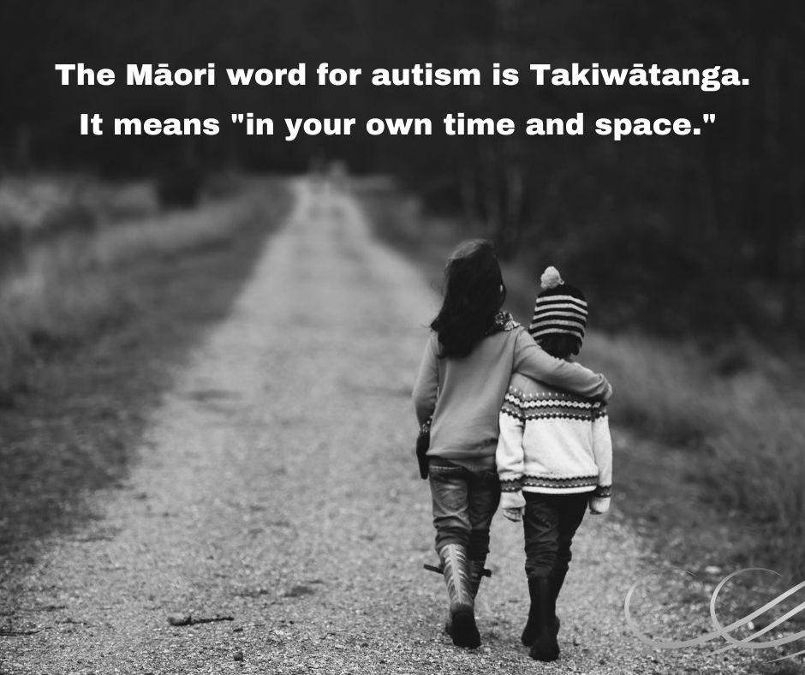
The Maori Word for Autism

Slide 14
Autism affects communication and social behavior.
Autism Society

Slide 15
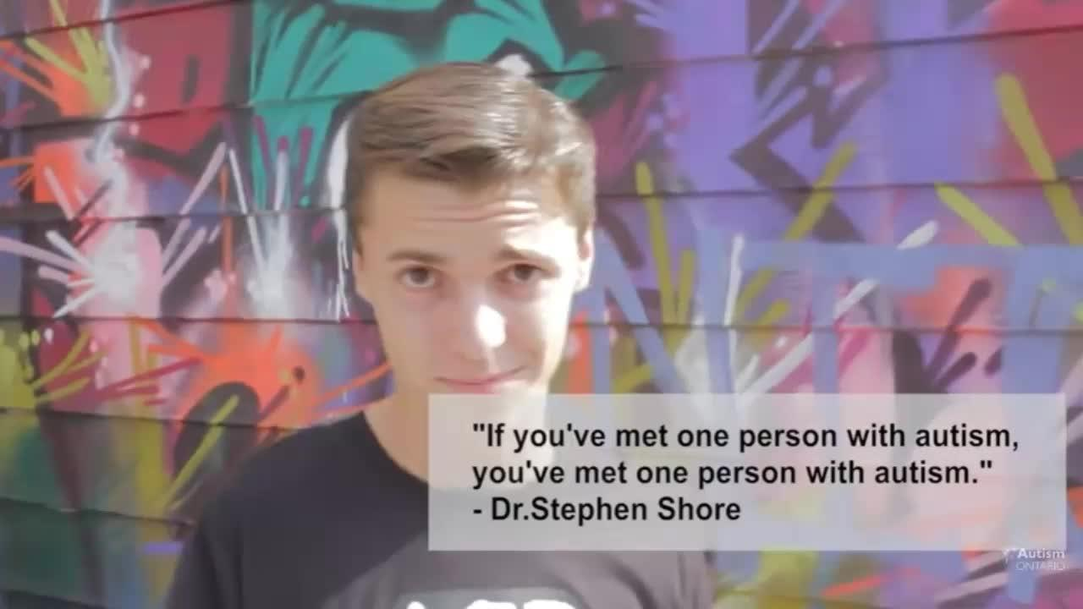
Michael McCreary Video
Michael McCreary, autistic comedian and author
Autism Ontario -- See the Potential with Michael McCreary

Slide 16
Autistic children and teens often have very specific, deep interests.
Autism Society

Slide 17
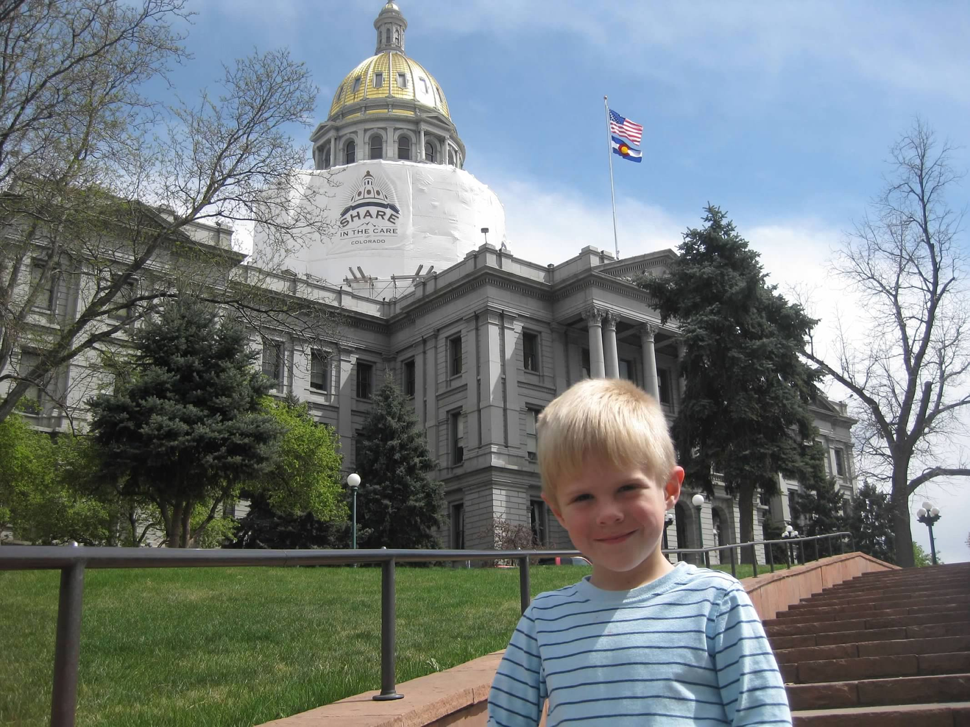
Doors Open Denver Architectural Tour, Age 4

Slide 18
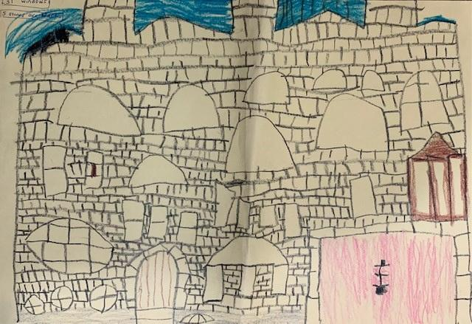
Example of an Autistic Child’s Deep Interests
"There are three turrets and the middle turret is the highest one.
The highest turret has a square-based pyramid roof and a balcony."

Slide 19
Autistic people are more likely to identify as LGBTQ+.
University of Cambridge

Slide 20
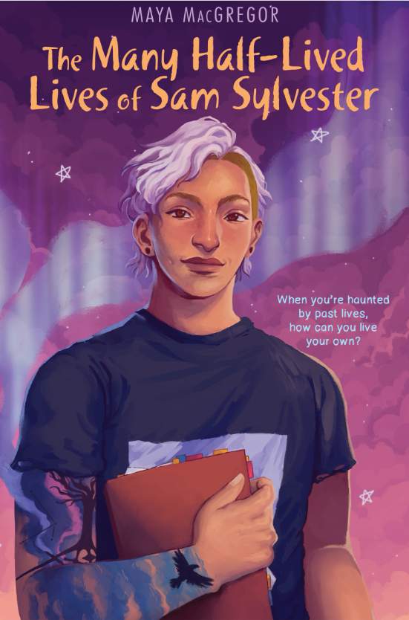
Example of a YA novel with authentic representation of an autistic, LGBTQ+ main character
“A top-notch blend of contemporary fiction and mystery with a satisfying conclusion [. . .] A thrilling debut.”
–Kirkus Reviews, starred review
“Readers will leave this poetic book feeling that Sam and the people surrounding them are completely real, along with the ghosts of Astoria.”
–Booklist
“Exhilarating […] Equal parts delicate and devastating.”
–Publishers Weekly, starred review
“A spine-tingling and romantic, character-driven story.”
-School Library Journal, starred review
Author Maya MacGregor's website

Slide 21
Young adults on the autism spectrum are more likely to be diagnosed with anxiety and depression and are at higher risk for suicide.
Spark for Autism

Slide 22


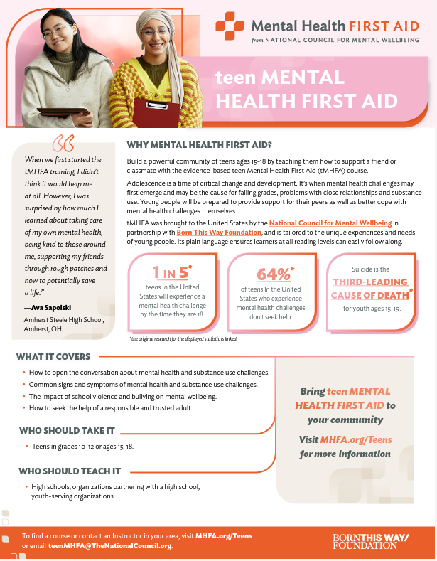


Examples of mental health resources for teenagers.
Search for courses
safe2tell marketing resources

Slide 23

What can WE do as librarians to better serve autistic youth and their caregivers?

Slide 24
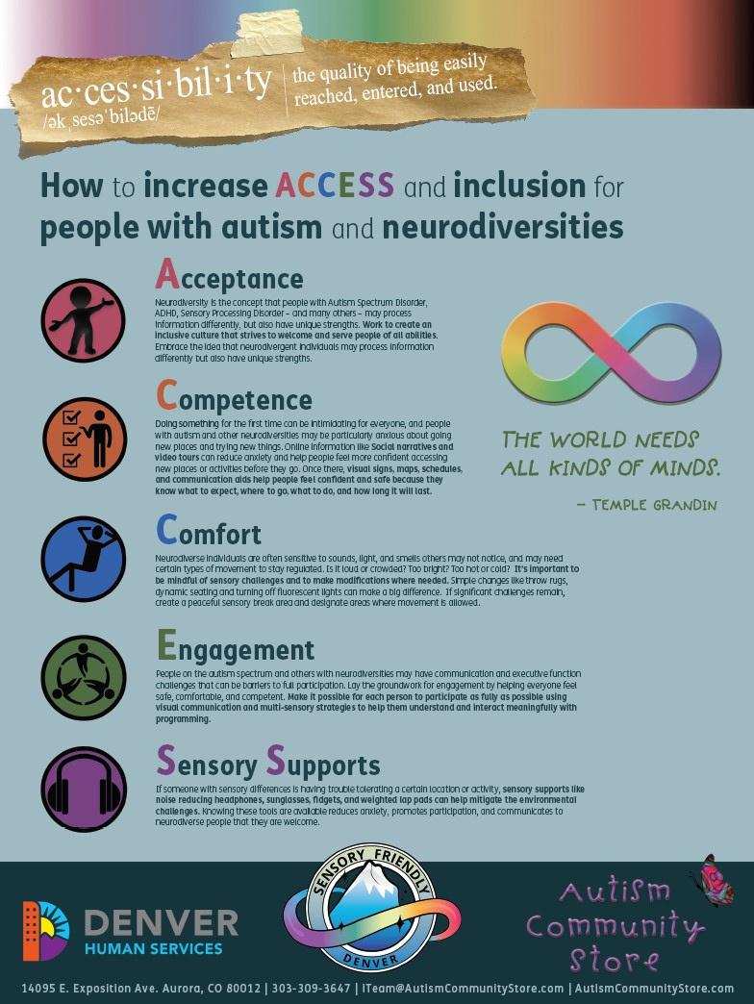
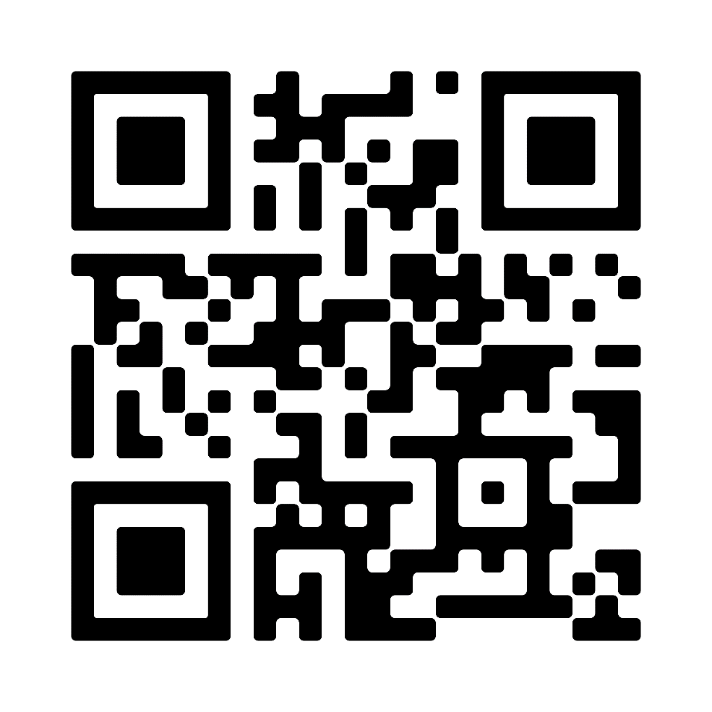
ACCESS Poster
Access a PDF copy of the ACCESS poster here.

Slide 25
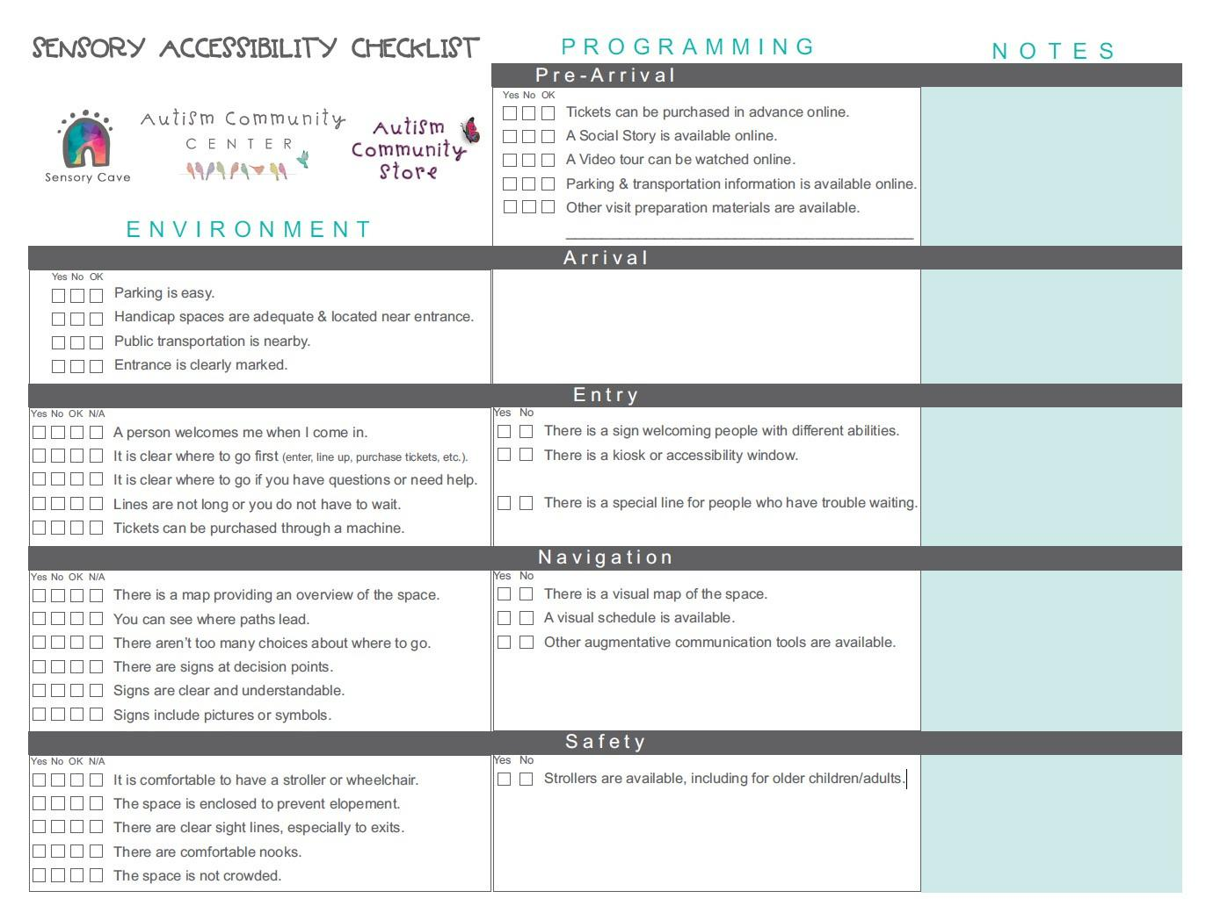
Sensory Accessibility Checklist
View the entire Sensory Accessibility Checklist here.

Slide 26

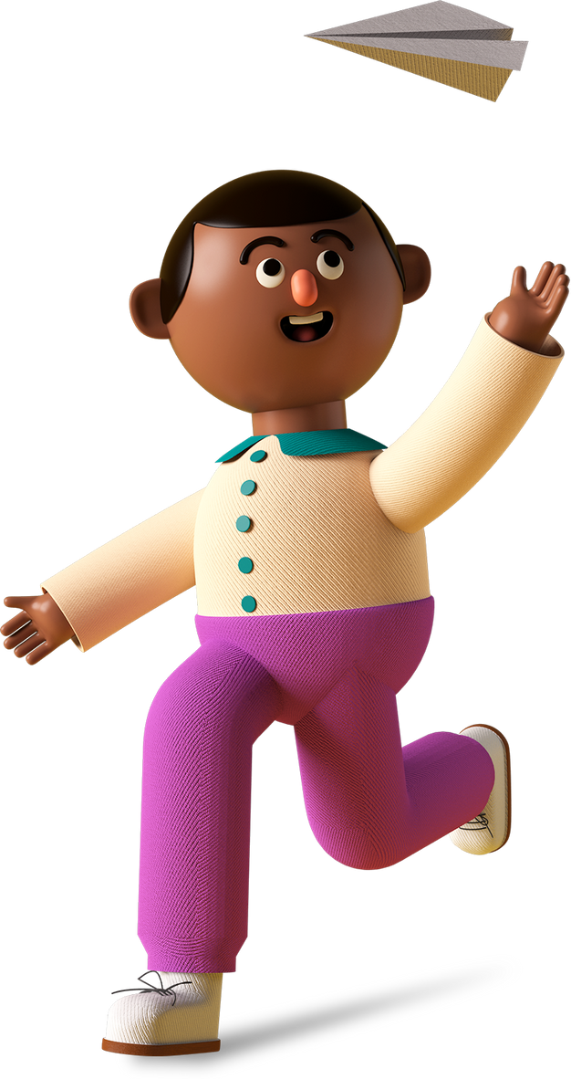
Librarians can model acceptance #1
1
1
Autism is a neurological difference.
"How can I help?"
"How can I support your child?"
Library workers' interactions with autistic patrons and their caregivers have the power to model inclusivity for patrons.

Slide 27
Librarians can model acceptance #2
1
"All of the employees have been super understanding of [my son] not being able to sit for story time and needing constant movement to stay regulated...he prefers to explore the space and it's one of the few places that we feel good about letting him."
"They are nice but lack kindness, they have sensory items for the children but they hover over the children to make sure we don't steal the equipment."
"The staff have been wonderful with our son. They're never taken aback by any of his sounds that can sometimes include screeching. They speak kindly to him and often get down on his level. Again, knowing that he's in a safe and welcoming space takes a lot of the pressure off for him to just be a kid and learn at his own time and pace."

Slide 28
Librarians can model acceptance #3
1
"She wasn't feeling well and had a lot of anxiety, so she couldn't attend a Teen center back to school activity and staff put aside a crafting kit for me to pick up for her to do at home. They even went looking for her favorite color."
"Many of the staff remember my child, ask about special interests, offer recommendations of books and games, show a lot of respect and trust of my child, and more. We are so so grateful for the staff who really honor the dignity in all."
"He loves talking to library staff about his interests.
He also loves when the library staff remember him and point out new books that interest him.”

Slide 29
Librarians can promote competence by sharing what to expect from the library experience.
2
Social narratives (sample)
Video modeling (sample)
Clear signage
Visual schedules (sample and Visual Schedules:
A Practical Guide for Families, University of Utah)

Slide 30
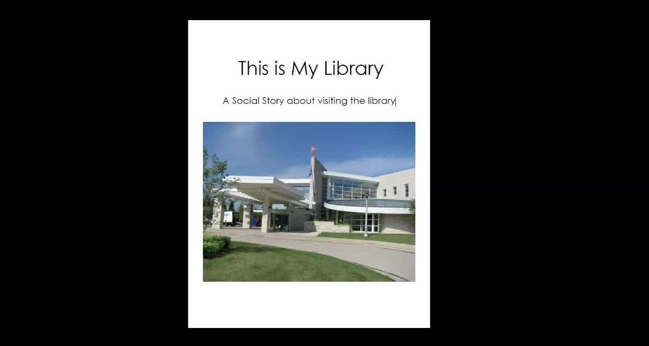
Example of a social story about visiting the library.
Menomonee Falls Public Library, WI

Slide 31
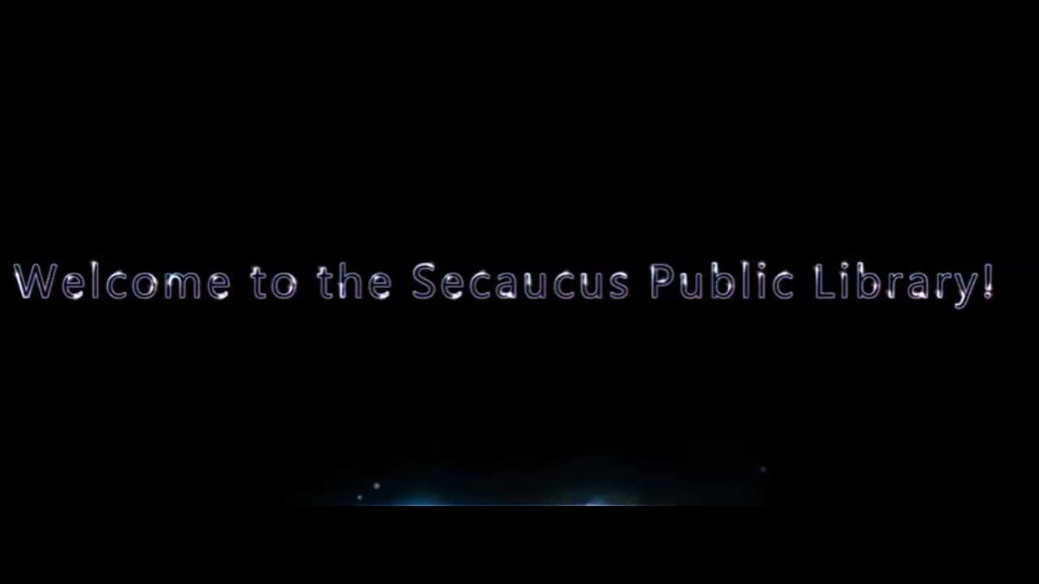
Secaucus Public Library, NJ

Slide 32
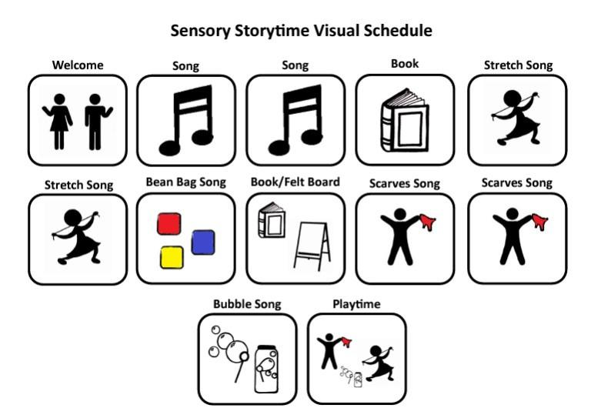
Finger Lakes Library System, NY

Slide 33
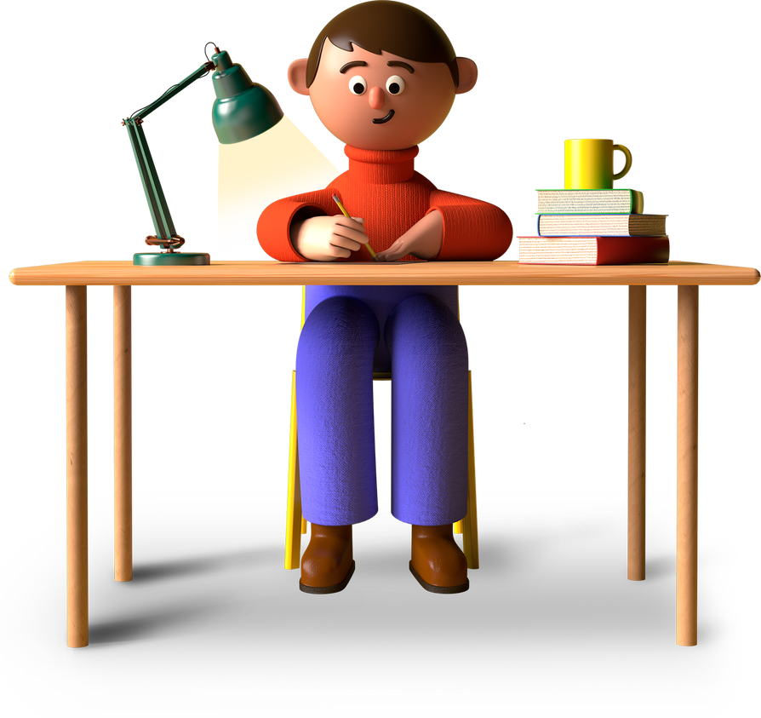
Librarians can create a comfortable library environment.
3
Sensory break area
Sensory equipment to self-regulate (headphones, manipulatives)
Low lighting
Quiet areas (quiet study zone)

Slide 34
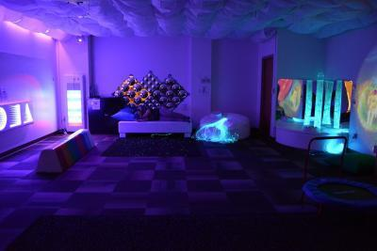
Louisville Public Library, OH
"The Discovery Center is designed for the special needs community, but all our patrons benefit." -- Jason Buydos, director of the Louisville (Ohio) Public Library

Slide 35
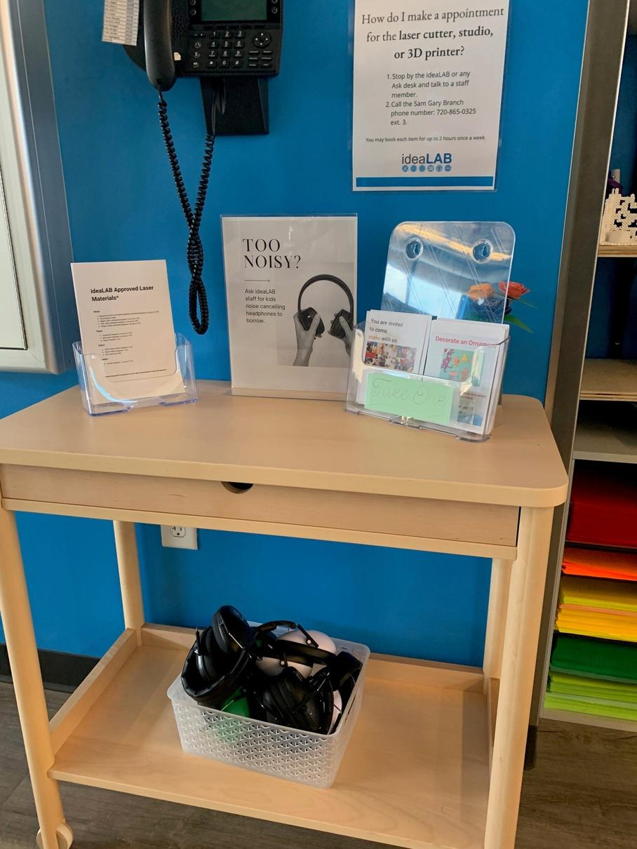
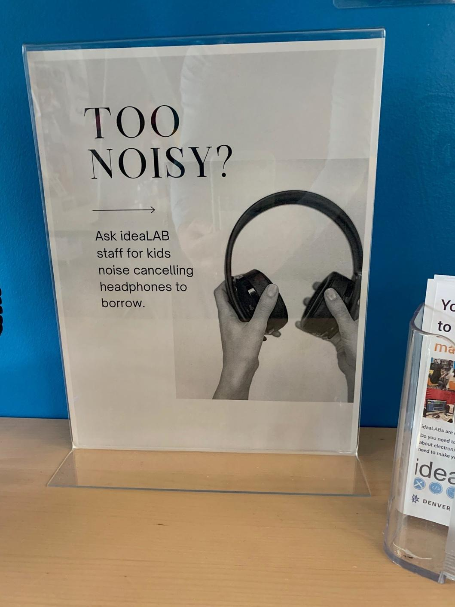
Example of library signage promoting sensory accommodations.
Denver Public Library, CO

Slide 36
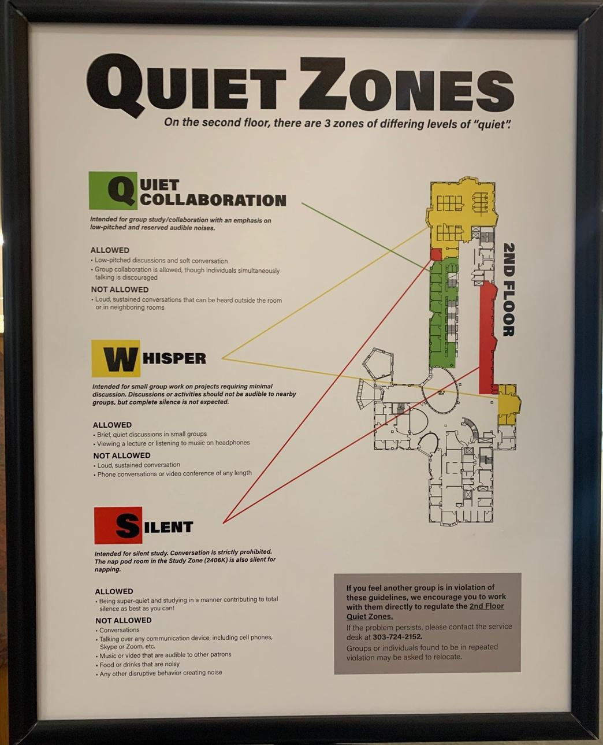
Example of sensory break zones.
Create zones for patrons
to take sensory breaks.
This does NOT mean your entire library has to be a whisper-only environment!
University of Colorado Strauss Health Sciences Library

Slide 37
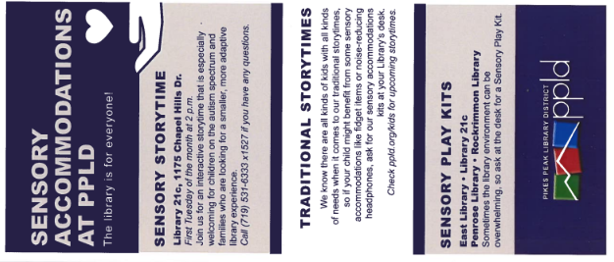
Librarians can offer inclusive programming
to engage autistic children and teens #1
4
4
Sensory-friendly makerspace hours
Sensory-friendly craft and STEAM events
Sensory-friendly storytime
Chess Club
Magik tournaments
Dungeons & Dragons meet-ups (virtual and in-person)

Slide 38
Librarians can offer inclusive programming
to engage autistic children and teens #2.
4
"Make sensory play a bigger thing in the children's area.
My kid is sensory seeking so playing with textures and smells is really exciting for him."
"More hands-on stuff is incredible.
I think the maker spaces and training in those things are great!"
"Have autism times or days celebrating autistic people."
"Offer programs specifically geared towards AAC communication.
We do lots of reading with the assistance of his device.
It would be nice to see that normalized in public."

Slide 39
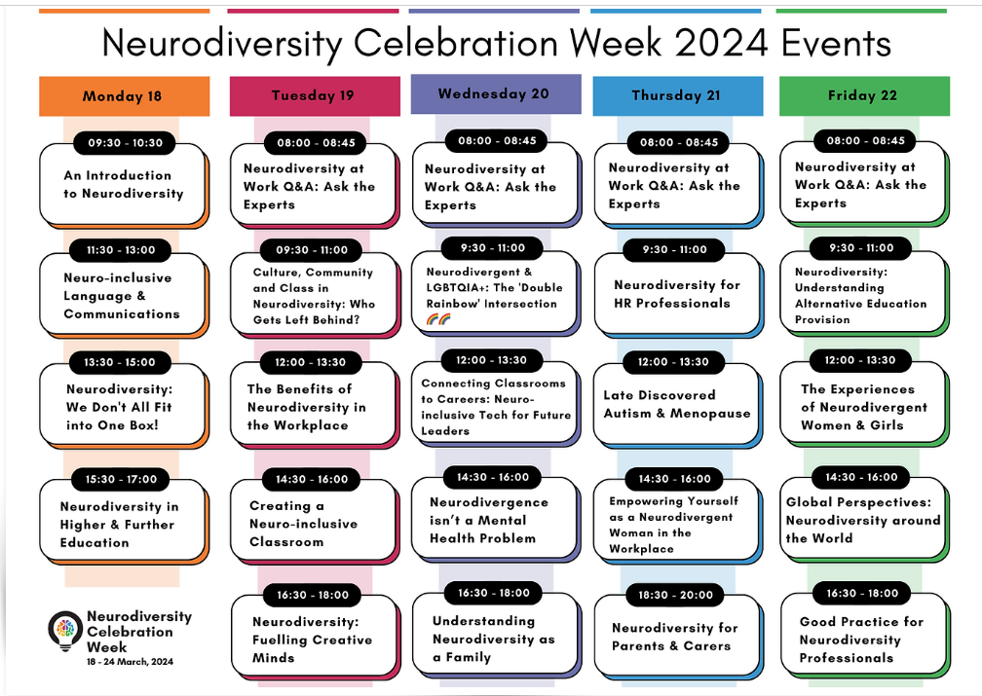
Neurodiversity Celebration Week
Neurodiversity Celebration Week: March 18-22, 2024
www.neurodiversityweek.com

Slide 40
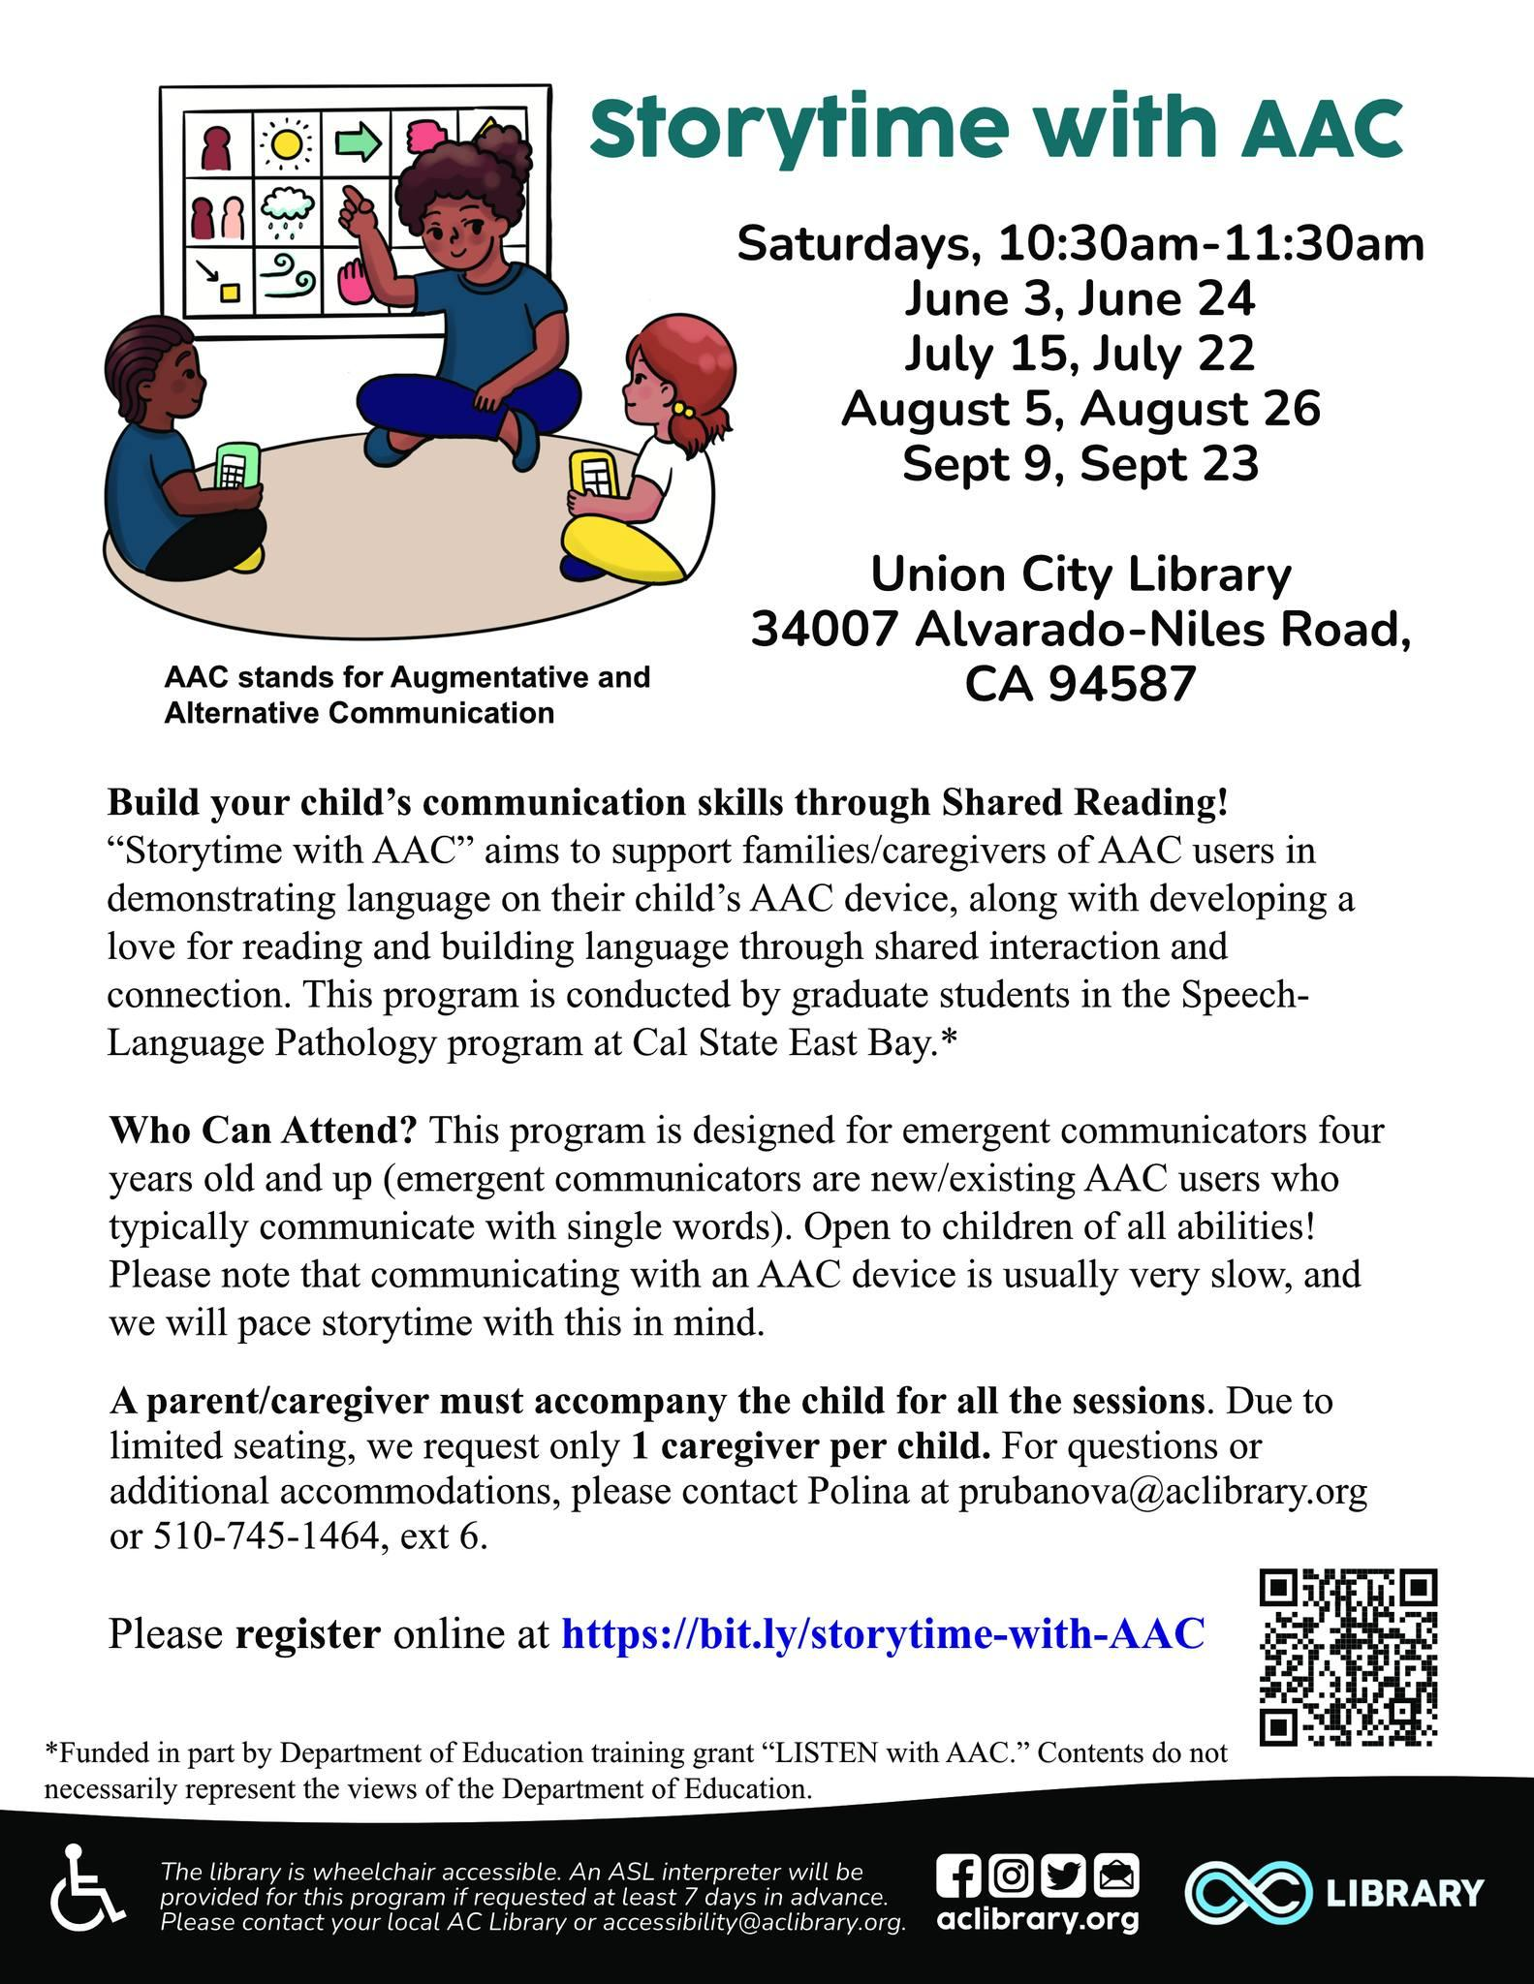
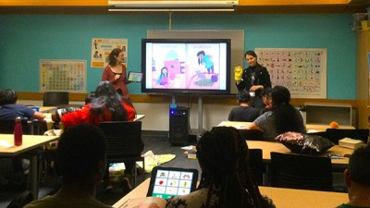
Storytime with Augmentative and Alternative Communication
“Serving Neurodiverse Needs in the Library,” Publisher’s Weekly
Photo credit: Marilyn Biu

Slide 41
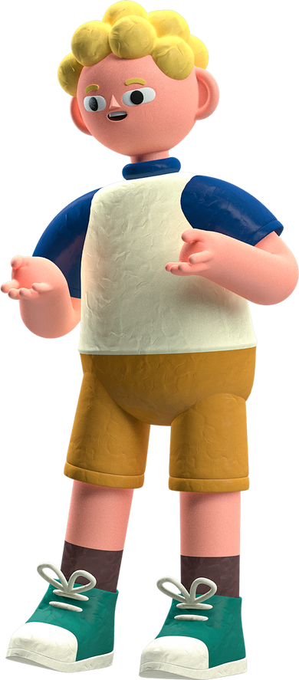
Librarians can help autistic youth and
their caregivers connect with one another #1
5
After-hours events for families and teens
Support group for caregivers of autistic youth
Support group for autistic teens and young adults

Slide 42
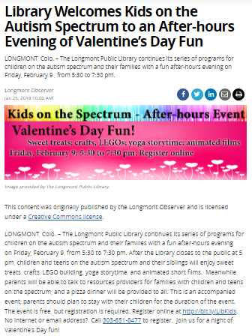
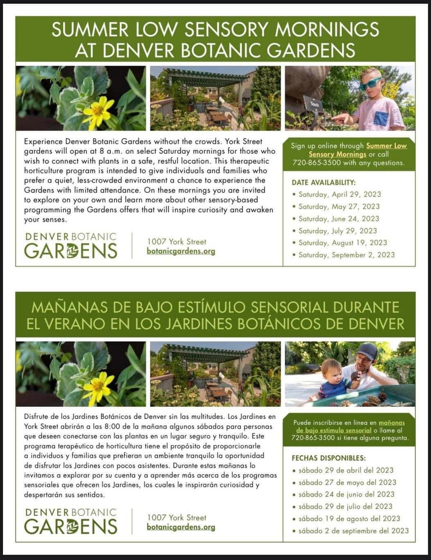
Examples of sensory-friendly programming.

Slide 43
Librarians can help autistic youth and
their caregivers connect with one another #2
5
"I have connected with other families going through similar family situations and changes.
It is amazing knowing others and not feeling so isolated when it comes to learning how to raise our children, especially neurodiverse children!"

Slide 44
Librarians can connect caregivers
with information and community resources.
6
6
Autistic Self-Advocacy Network
Organization for Autism Research
Autism Society (national org and local affiliates)
Neurodiversity Celebration Week

Slide 45

Example of community resources for autistic children, teens and adults.

Slide 46
Librarians can connect caregivers with information
and community resources.
6
"When my son hit puberty, I wanted some books to help me explain it to him, so I reached out to the children's librarian. She put me in touch with a regional library autism specialist, who then did some research and came up with 3 book recommendations.
The books weren't available through the library, but the library purchased them, which amazed me. All 3 books were good and one was ideal. I ended up buying a copy for myself.
My son and I read it a few pages at a time over several months and it made the various puberty changes much more comfortable for him."

Slide 47

Librarians can curate a collection of books with authentic, affirming representation of neurodiversity.
7
AVOID
The Emotionless and Robotic Savant
The Annoying Sibling or Sidekick
The Unrealistic Inspiration
The Walking Diagnosis
LOOK FOR:
Autistic Main Characters
Multiple Autistic Characters
An Internal View of Autism
"Autism Representation in Books" by Adriana White

Slide 48
Poll number 1
What percentage of today’s participants have read a book
with authentic, affirming
representation of autism?

Slide 49
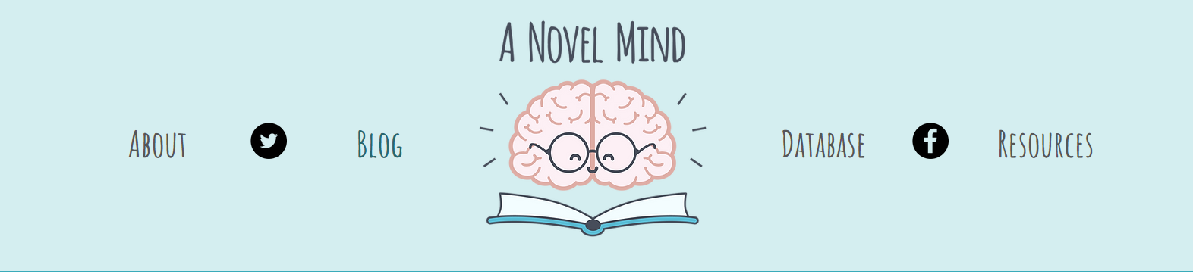
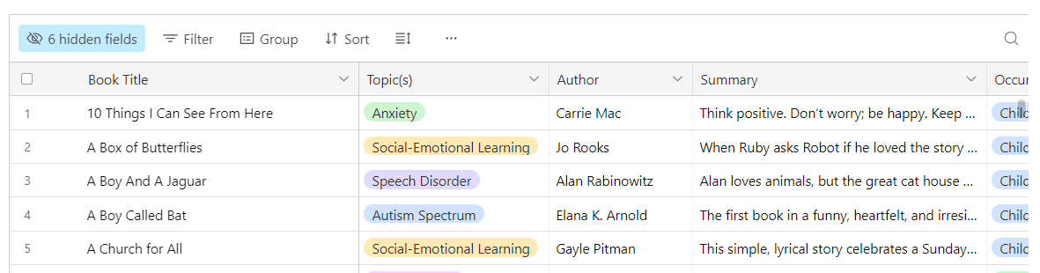
anovelmind.com

Slide 50
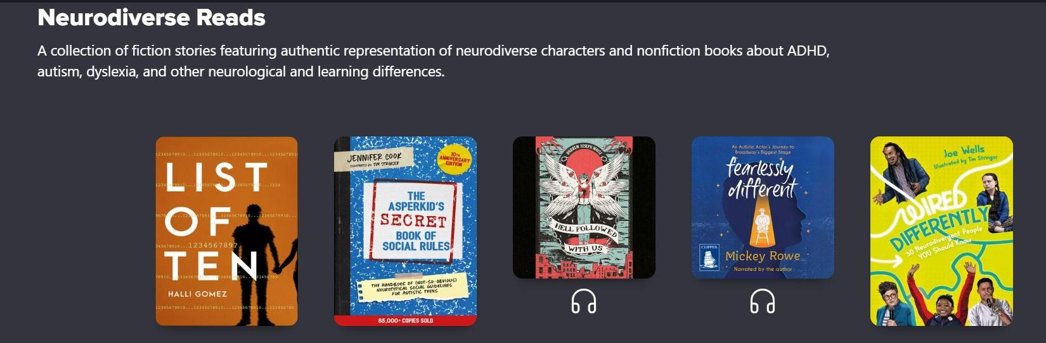
Denver Public Schools' eBook and audiobook Neurodiverse Reads Collection
131 eBooks, 16 audiobooks

Slide 51

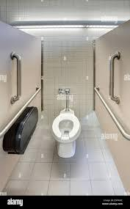
Librarians can advocate for school libraries as safe havens for autistic children and teens to take sensory breaks and avoid bullying #1
8
8

Slide 52

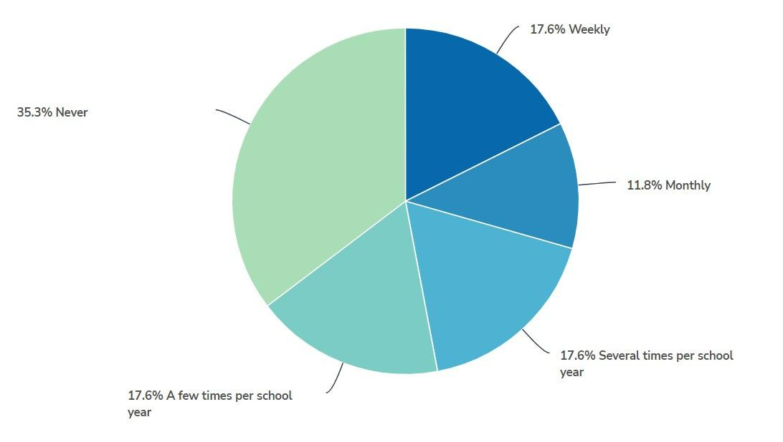
Librarians can advocate for school libraries as safe havens for autistic children and teens to take sensory breaks and avoid bullying #2
8
Which of the following best describes your child's school library usage?

Slide 53
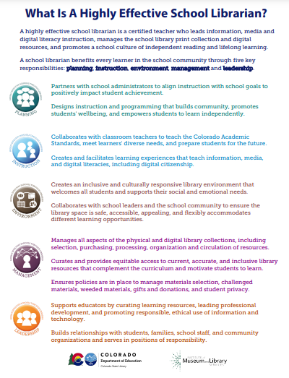

Colorado State Library School Libraries Communication Toolkit
Colorado State Library: School Libraries Communication Toolkit

Slide 54
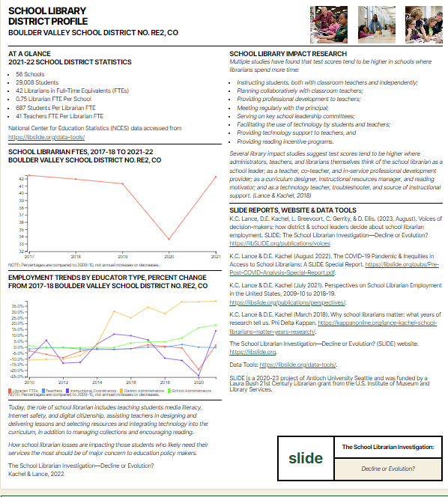
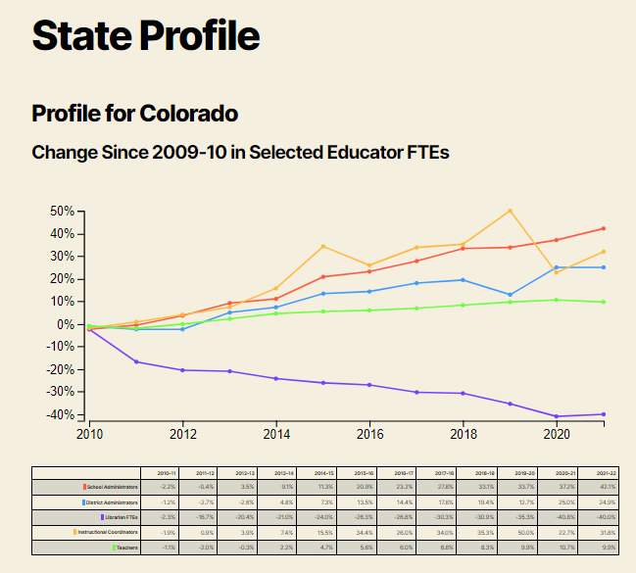
SLIDE Project District and State Profiles
SLIDE Project District and State Profiles

Slide 55

Quote about biodiversity and neurodiversity.
Just as a rainforest with biodiversity is equipped to adapt and respond to threats, humanity needs neurodiversity.
We all benefit when we have different kinds
of minds solving the world's problems,
creating our works of art, and enriching our communities.
~ Adriana White

