Slide 1
Adventures in Library Partnerships

Slide 2
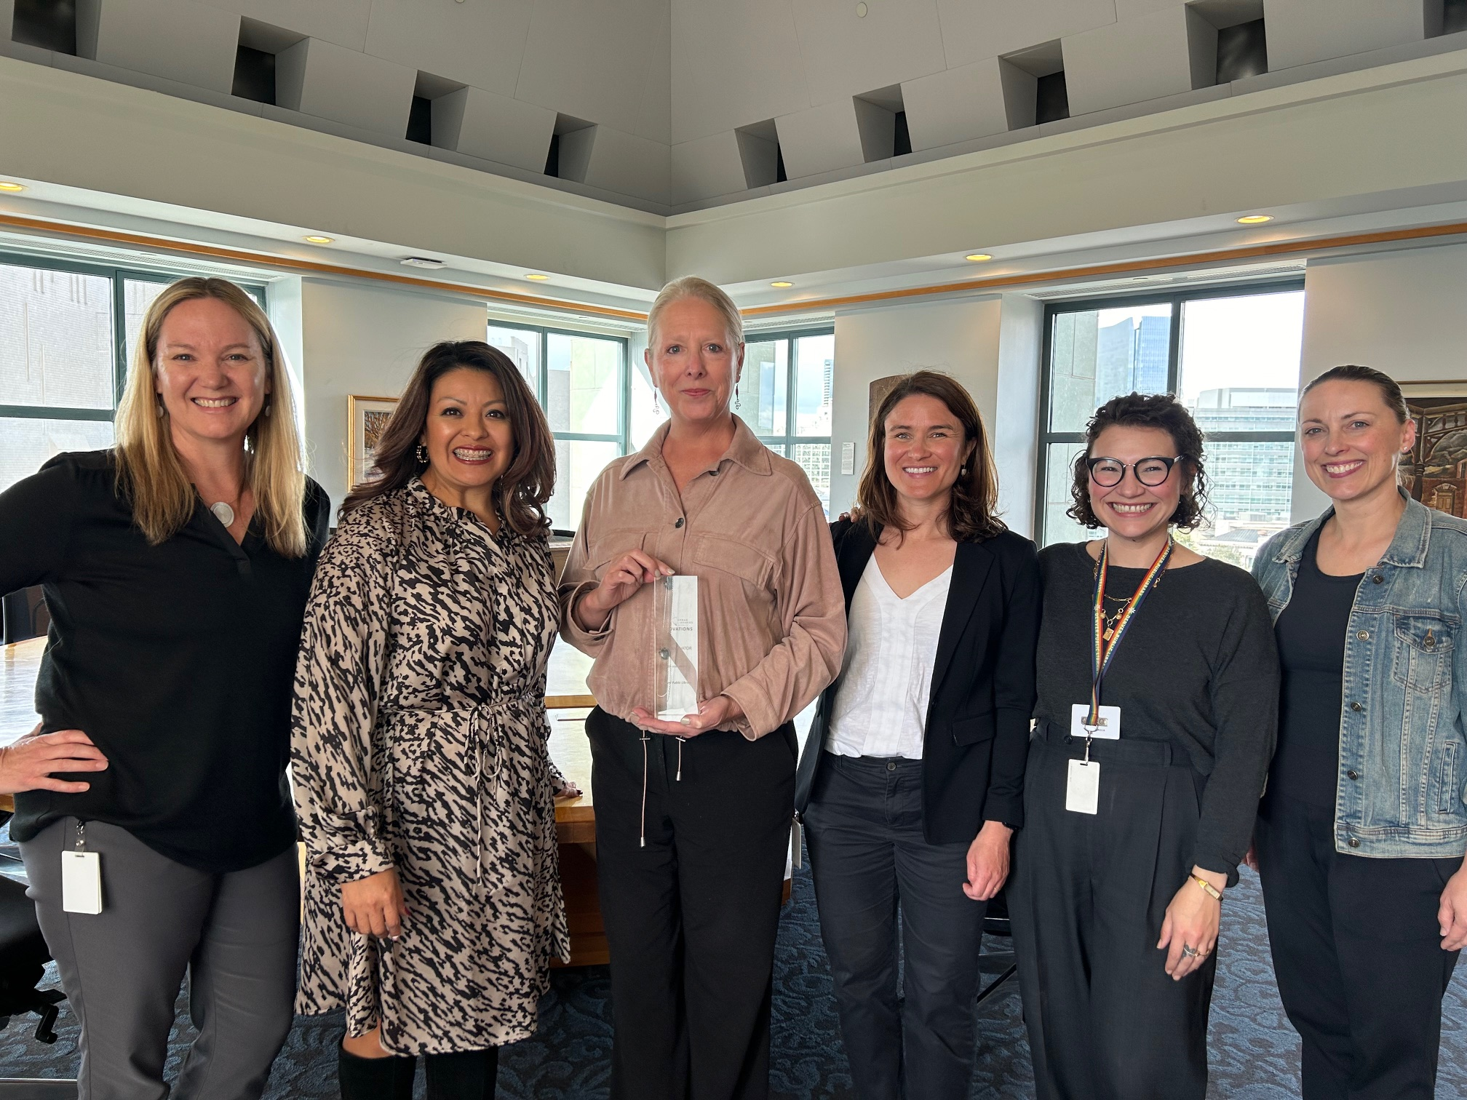
Introduction- Beth Warren and DPL
Strategic Partnerships
8 years @DPL
Varied role
Quick partnership stats:
  143 partnerships
  1 partnership staff member
  Every division involved

Slide 3

Session Agenda
Why Partnerships Are Important
Building Blocks of Partnership
Finding Your Partners
Setting Expectations
Challenges & Benefits
Choose Your Partnership Adventure!
Partnership Resources

Slide 4
Why Partnerships Are Important to Libraries
Libraries can be asked do it all, but should they? Partnerships can…
Provide libraries with opportunities to enrich or expand services without overextending capacity
Create shared resources and responses to community needs
Create avenues to reach new customers, and communities
Allow each partner to do what it does best- using unique skills and expertise to serve needs

Slide 5

Setting Yourself Up for Success- The Building Blocks
Does your library have…
A vision, mission, core values?
An understanding of community needs?
A strategic plan or annual plan to guide your work?
Enthusiastic staff to work with partners?
Systems in place to manage partnerships?

Slide 6
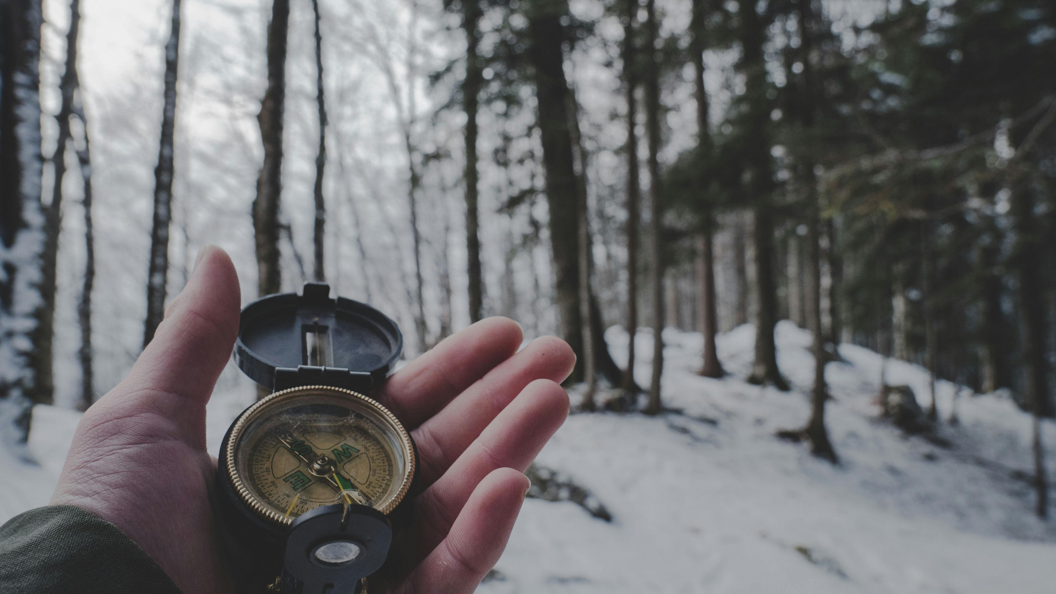
Finding Your Partners
Identify where community needs and partnerships align
Meeting people and building relationships is key
Setting the stage for the work

Slide 7
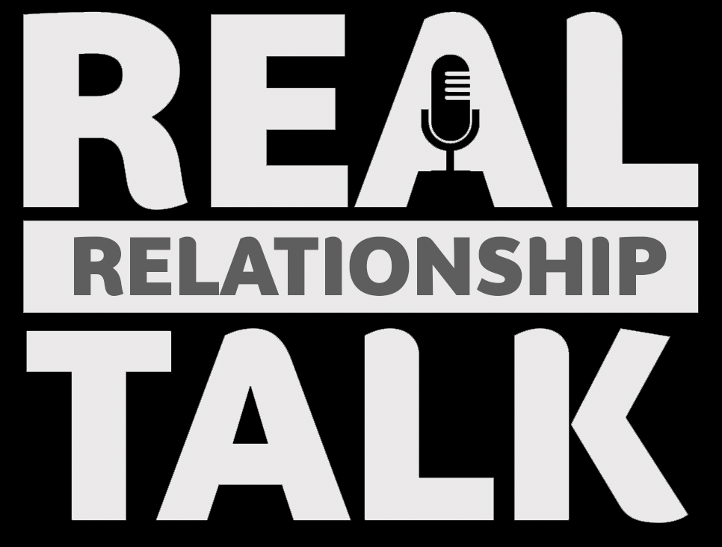
Setting Expectations
The “relationship talk” of the partnership world
Co-creating the plan
No Fewer surprises and misunderstandings
The really fun part- the legal stuff

Slide 8
Common Partnership Challenges & Benefits
Challenge #1: Unclear expectations from one or more partners
Challenge #2: Misaligned partnership activities
Challenge #3: Partnership no longer serves its purpose
Benefit #1: Everyone does what they do best
Benefit #2: Partnerships can fill service or budget gaps by working “through” the library
Benefit #3: Partnerships can build or strengthen community connections

Slide 9
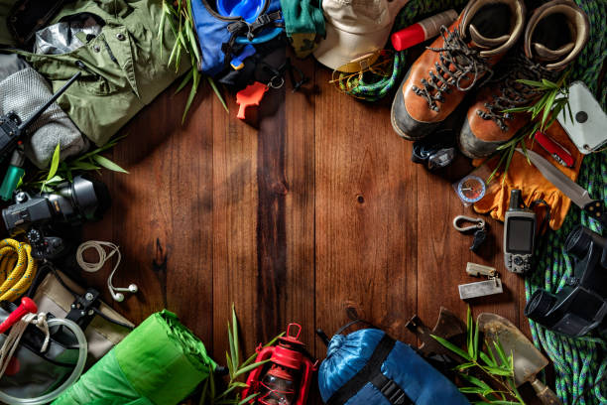
Let’s Choose our Partnership Adventure!

Slide 10

Adventure = Walking
Mutually Supportive Partnerships!
What does it take?
Planning
Light gear
Enjoyable route
Who should walk with you?
Trusted person
Prepared and engaged
Committed

Slide 11
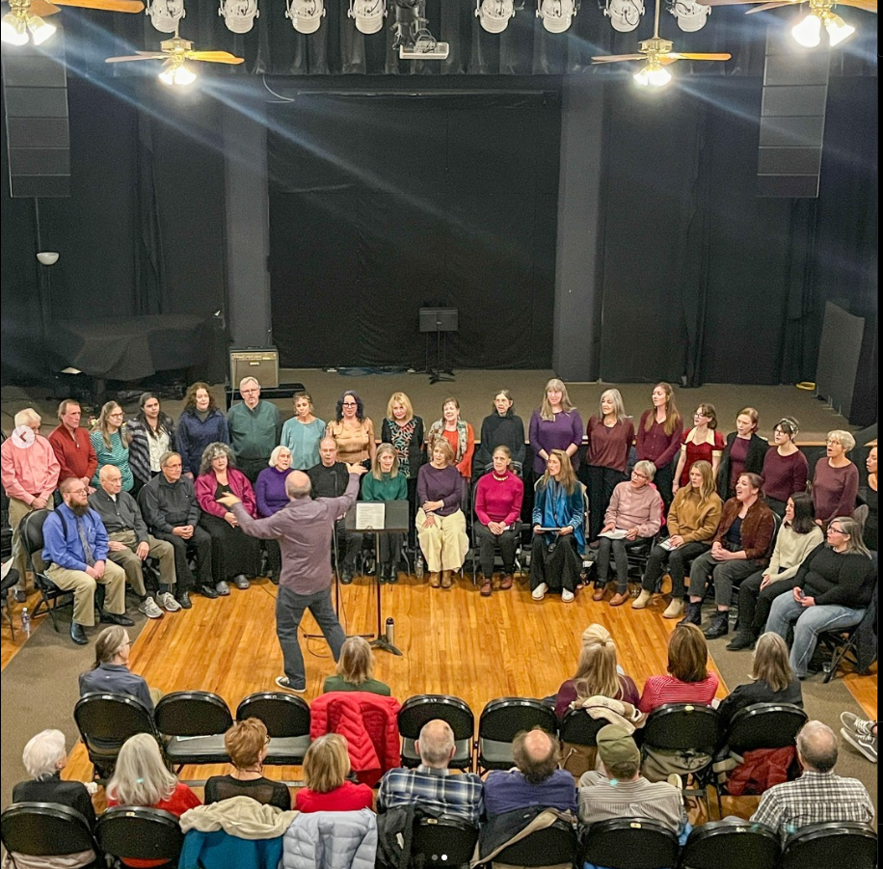
Mutually Supportive Partnership Examples
Museum & Cultural Pass Program
All Ages Choir-Older Adult Services
Literacy organizations

Slide 12
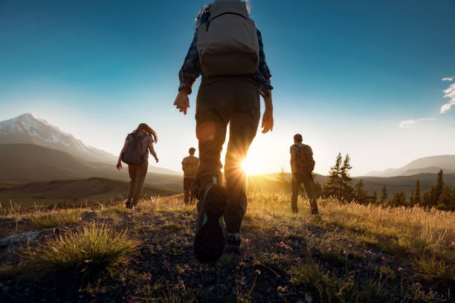
Adventure = Hiking
Co-Created Partnerships!
What does it take?
More planning than a walk
Light, but critical gear
Willingness to change course if needed
Who should hike with you?
Trusted collaborator
Adaptable and curious
Brings the right gear, but not too much

Slide 13
Co-Created Partnership Example
What: Museum & Library Partnership
Purpose: building on existing successes with co-created activities to meet specific community needs and measure their effectiveness

Slide 14
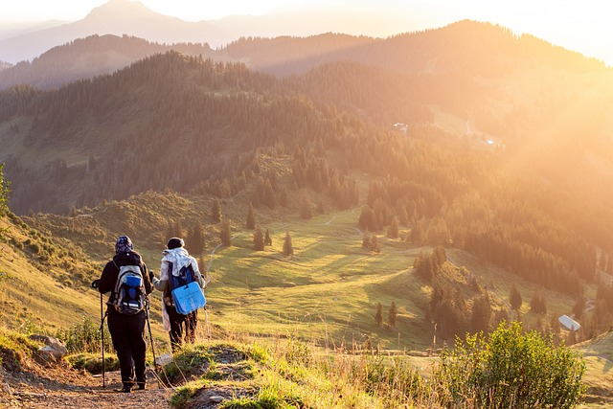
Adventure = Trekking
Government Agency Partnerships!
What does it take?
More challenging path
Delayed or slower to implement
Higher risk, but higher reward
Who should trek with you?
Sturdy friend
Understands the mission
Has quality insurance

Slide 15

Government Agency Partnership Example
What: Public health agency partnership
Purpose: provide vaccine clinics at library locations to increase uptake and improve health outcomes among Denver residents

Slide 16
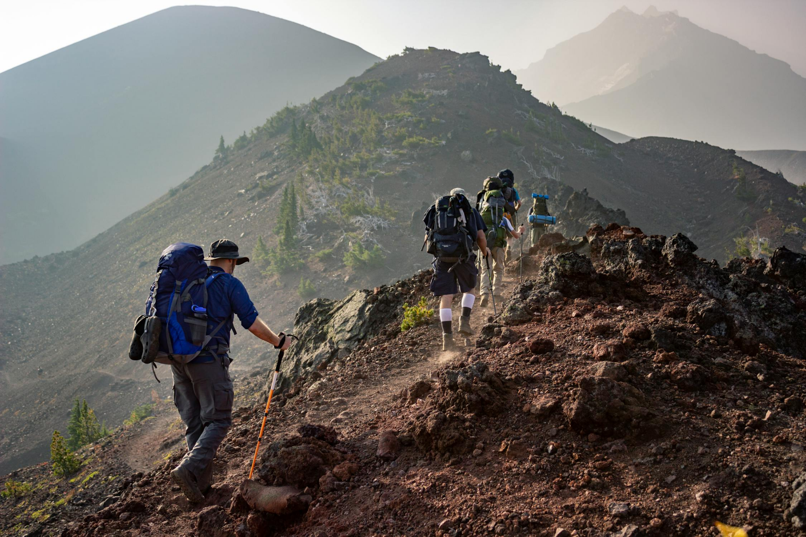
Adventure = Mountaineering
Grant Partnerships!
What does it take?
A detailed map
Gear that is built for the task
Adventurous spirit
Who should go mountaineering with you?
Big and small thinker
Planner, doer, adjuster
Someone adventure-ready

Slide 17
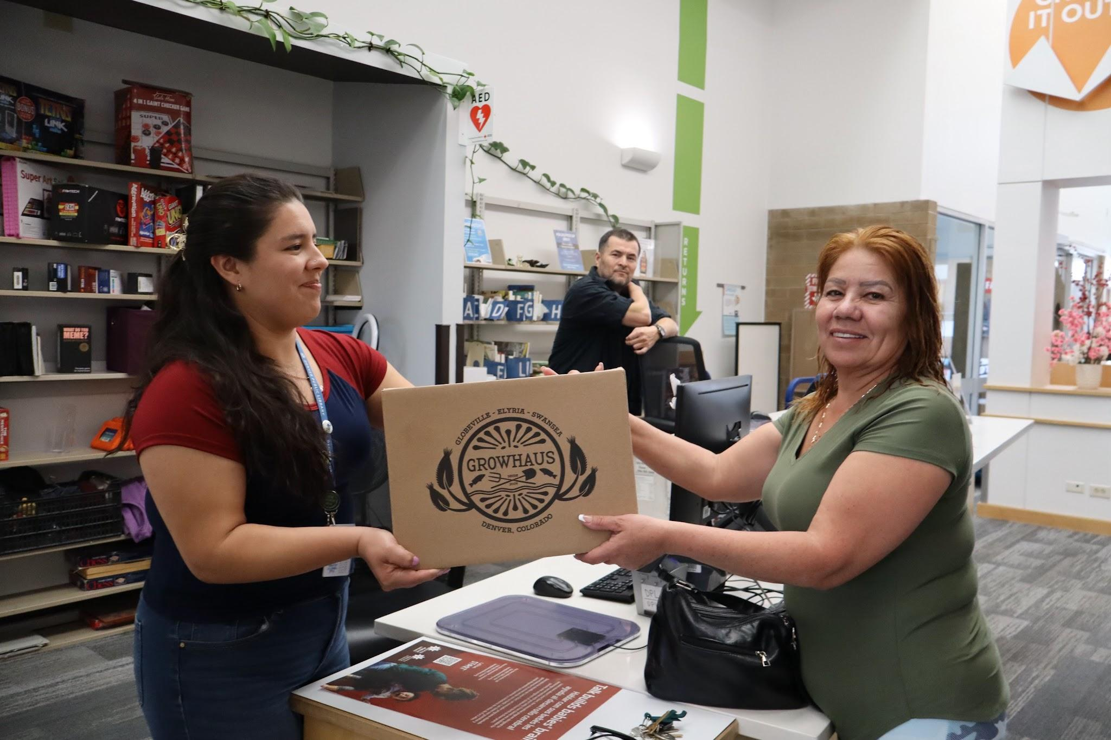
Grant Partnership Example
What: Nonprofit food justice organization and library partnership
Purpose: connect grant-funded food box delivery to resident families in need, via library locations

Slide 18
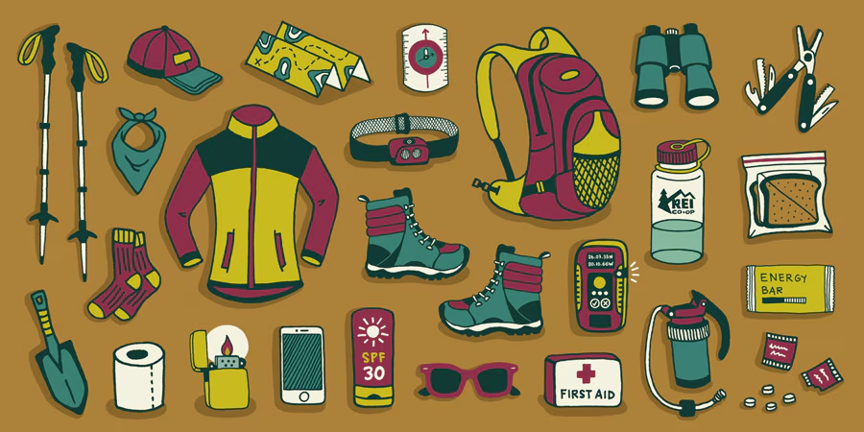
Building Your Partnership Adventure Kit
Essentials:
Defined community needs
Solid relationships
Capacity
Advanced Gear:
Partnership outline/agreement
Budget/funding
Measurement/Evaluation

Slide 19
Don’t Build it from Scratch- Use Peer Resources!
Partnership Guides or References
Denver Public Library’s Partnership Guide
Healthy Eating & Active Living Partnership Guide
ALA Resources
School-Library Partnership Toolkit
Young Adult Library Services Association Strategic partnership guide
Partnering for Stronger programming toolkit
Let’s Move In Libraries- UNC Greensboro School of Education
I Partner With My Public Library Awards

Slide 20
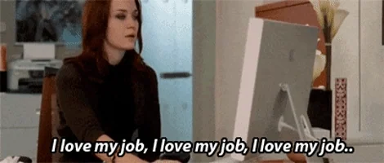
Ask Me Anything
And Keep In Touch- ewarren@denverlibrary.org
Notes:
Image credit: https://media.tenor.com/BhHBhPkMA2EAAAAM/devil-wears-prada-mantra.gif

