Slide 1

THIS IS A CLiC PRESENTATION

Slide 2
Mastering the Juggle: Flexible Collection Development
2024 CLiC & Connect
Presented by Chelsea Coleman
Notes:
9:45-9:46 (30 sec)
All coll dev is susceptible to adaptation

Slide 3
TODAY’S ROADMAP
Collection management vs. collection development
Guidance and tips on making selections
Lightning thoughts on other collection management topics
Notes:
9:45-9:46 (30 sec)

Slide 4
COLLECTION MANAGEMENT
Select
Acquire
Process
Circulate
Maintain
Evaluate
Collection Development
Notes:
9:46-9:48 (2 min)
Mgmt includes coll dev and more – budgeting, maintenance, etc.
Coll dev is only one aspect – identification and acquisition of materials
Evaluation plays such a large role in coll dev that I consider it to be part of it even if traditionally it’s not.

Slide 5
How long have you been involved with collection management?
0 years
10+ years
Notes:
9:48-9:52 (4 min)

Slide 6
PROFESSIONAL ETHICS
Freedom to Read Statement, Proposition 2:
Publishers, librarians, and booksellers do not need to endorse every idea or presentation they make available. It would conflict with the public interest for them to establish their own political, moral, or aesthetic views as a standard for determining what should be published or circulated.
ALA Code of Ethics, Principle 7:
We distinguish between our personal convictions and professional duties and do not allow our personal beliefs to interfere with fair representation of the aims of our institutions or the provision of access to their information resources.
Notes:
9:52-9:54 (2 min)

Slide 7

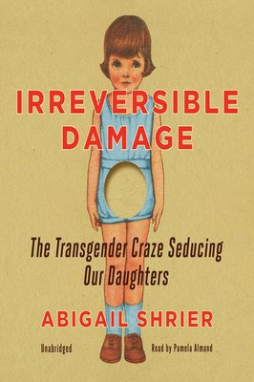
Notes:
9:54-9:58 (4 min)
Open conversation with attendees: Is selection a form of self-censorship? How far should you go to provide materials that do not appear to reflect local interests in the name of balance and information freedom? (Collection Mgmt Basics, 2019)
One Hundred Proofs: originally published in 1885, updated edition is self-published
Irreversible Damage: treats transgender as mental illness

Slide 8

IT’S NOT YOUR COLLECTION.
Remain objective.
Consider item types.
Use regular collection mapping and community analysis.
Let patron requests guide you.
Notes:
9:58-10:02 (4 min)
Objectivity: Shift from first person to third person when making a decision. Consider local context and cultures. (Example: A community with a large veteran population may like war NF books)
Item types: What about reference? Is it necessary to maintain extensive encyclopedia collection? Is it necessary to restrict lending of titles?
Community analysis: We’ll get to this in a bit.
Patron requests: You don't have to buy everything requested. It's not censorship to decline to purchase a book that has questionable facts and/or includes blatant hate speech.
Most important thing to remember: It's not your collection.

Slide 9
TYPES OF NEED
Normative needs – measurable against standards and often based on expert opinion
Felt needs – reflect individual wants and not necessarily what’s good for the community
Expressed needs – demands that felt needs be met; risk of overresponse and neglect of non-users
Comparative needs – based on like populations
Notes:
10:02-10:06 (4 min)
(Collection Mgmt Basics, 2019)
Normative – Core Collection volumes
You will never satisfy everyone's information needs and collection wants. (Example: Rihanna's $100 book)

Slide 10
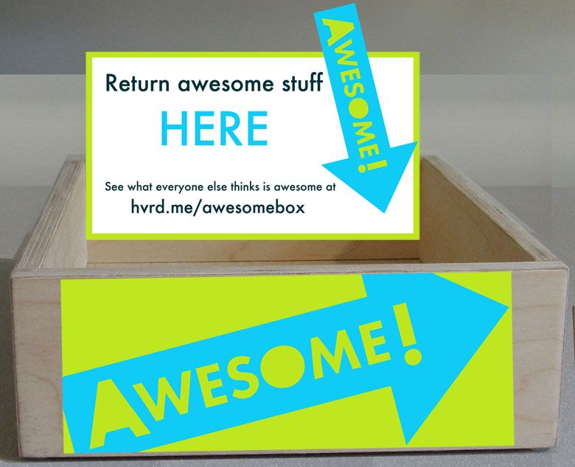
QUICK & EASY COMMUNITY ANALYSIS
Collect demographic data.
Launch Facebook or AspenCat polls.
Regularly view collection stats.
Employ talkback boards.
Consider an awesome box.
Notes:
10:06-10:11 (5 min)
Reach out to Board of Ed for their stats.
Don't leave out non-users. Collection should be responsive to future users, too. This is where demographic data comes into play.

Slide 11
COLLECTION MAPPING
What's your collection's purpose?
What's the age of your collection?
How is your collection used?
Where is your money going?
Create a collection plan accordingly.
Notes:
10:11-10:14 (3 min)
(Data-Driven Decisions, 2024)
All about looking at quantity and quality to identify strengths and weaknesses
1. What's the focus?
2. Age - Start with top level classification (000, 100, 200…) then drill down.
3. Public libraries can't get specific user data (unless they track birthdates). Schools could use student year.
These questions all lead you to discover strengths/weaknesses.

Slide 12
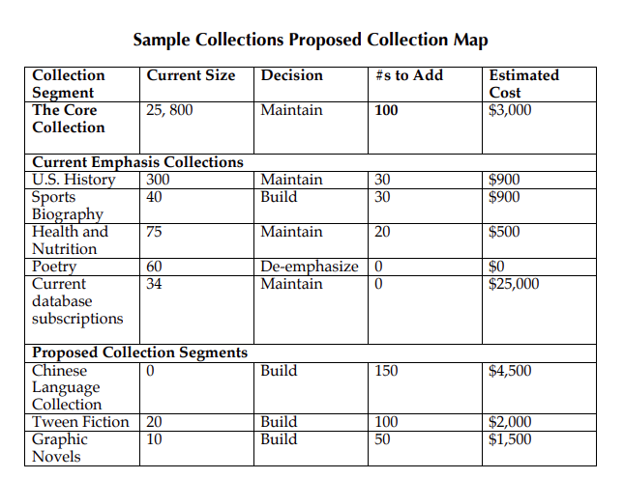
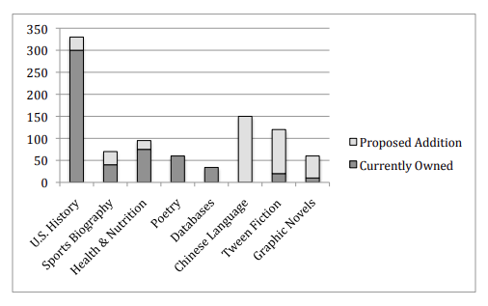
Notes:
10:14-10:15 (1 min)
(Using the Collection Mapping Technique: A Guide for Librarians by Loertscher)

Slide 13
START MAPPING YOUR COLLECTION.
Notes:
10:15-10:21 (6 min)

Slide 14
SO MANY TITLES, SO LITTLE TIME!
Check out reviews and lists.
Look at what's popular in similar communities.
Pick the brains of your staff and board.
Ask your local experts, organizations, support group consultations, etc.
Like other libraries and publishers on social media (Litsy, BookTok), and follow book articles
Notes:
10:21-10:29 (8 min)
Reviews & lists: validity, where to find, LJ/SLJ starred reviews, awards, Core Collection volumes; Tiah Frankish webinar on reading a review
LRS.org: Find comparable/neighboring libraries and search their catalogs. What do they have multiple titles of? Can you sort their catalog by popularity?
Everyone geeks something. Identify what your staff and board members geek and ask for recommendations. For staff, they can also take charge of specific areas. Maybe you have a staff member who loves knitting? Or a board member who always knows the latest Christian fic title?
Ask for recommendations from external parties who have specializations. Do you have a local gardening club, hospital or support group?

Slide 15
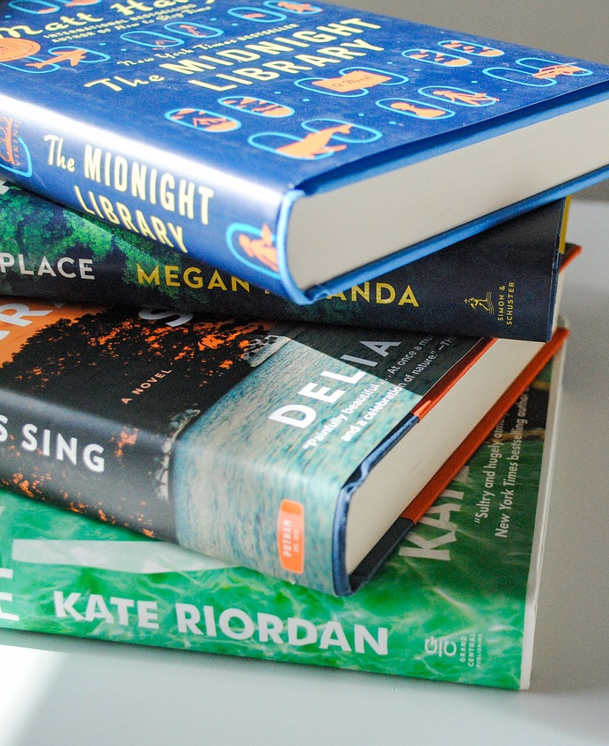
VENDOR SERVICES
Auto-purchasing
Vendor selection
Leasing
Processing
Notes:
10:29-10:37 (8 min)
Examples of vendors and the general process for auto and vendor selections (B&T, Ingram, JLG) – rely on curated lists of items
Is leasing a good option? It depends. It can be cheaper when you need more than one copy of a new bestseller and if you don't have access to resource sharing. You can also choose to purchase the item after the lending period is over if it's determined that it should remain in the collection.
Vendors can handle processing, including mylar jackets, spine labels and more. They also provide MARC records that you can upload in advance. When titles arrive, you simply add a new item record and link them in your catalog.
Examples:
Auto-purchase all Danielle Steel titles in regular and LP
Use JLG for juv graphic novels
Lease four copies of James Patterson and only purchase one for your non-New shelf

Slide 16

Short Pause
Notes:
10:37-10:45 (8 min)

Slide 17
PRACTICE.
Notes:
10:45-11:10 (25 min)

Slide 18
Lightning thoughts
Policy Content
Maintenance & Evaluation
Browsable Collections
Non-English Collections
Diversity Audits
Staying on Budget
Notes:
11:10-11:10 (0 min)
Handout reflection questions sheet

Slide 19
POLICY CONTENT
Purpose of collection
Topics and formats covered
Selection criteria
Evaluation of collection
How challenges are handled
Notes:
11:10-11:15 (5 min)
CLiC’s Public Library Policy Collection
(Collection Mgmt Basics, 2019)
REFLECTION QUESTION: What is one thing you are still pondering?

Slide 20
MAINTENANCE & EVALUATION
Set a collection evaluation schedule.
Everyone should be in on it.
Consider these data points when weeding: last circulation, DOA, grubby list, publication year.
Consider marking items that should remain.
Notes:
11:15-11:20 (5 min)
The easiest way to stay on track and ensure each part of your collection is looked at is to set an annual schedule. For example, look at your YA fiction every January, your media every Feb, etc. This evaluation includes pulling data for a weeding list along with a visual inspection of the area.
Every touchpoint is an opportunity for staff to assess the value of the item. Does it look MUSTIE? Explain MUSTIE here: Misleading, Ugly, Superseded, Trivial, Irrelevant, Obtainable Elsewhere
To save time: mark "core" items and unique items to be retained, Core Collection volumes
REFLECTION QUESTION: What strategies did you discover?

Slide 21
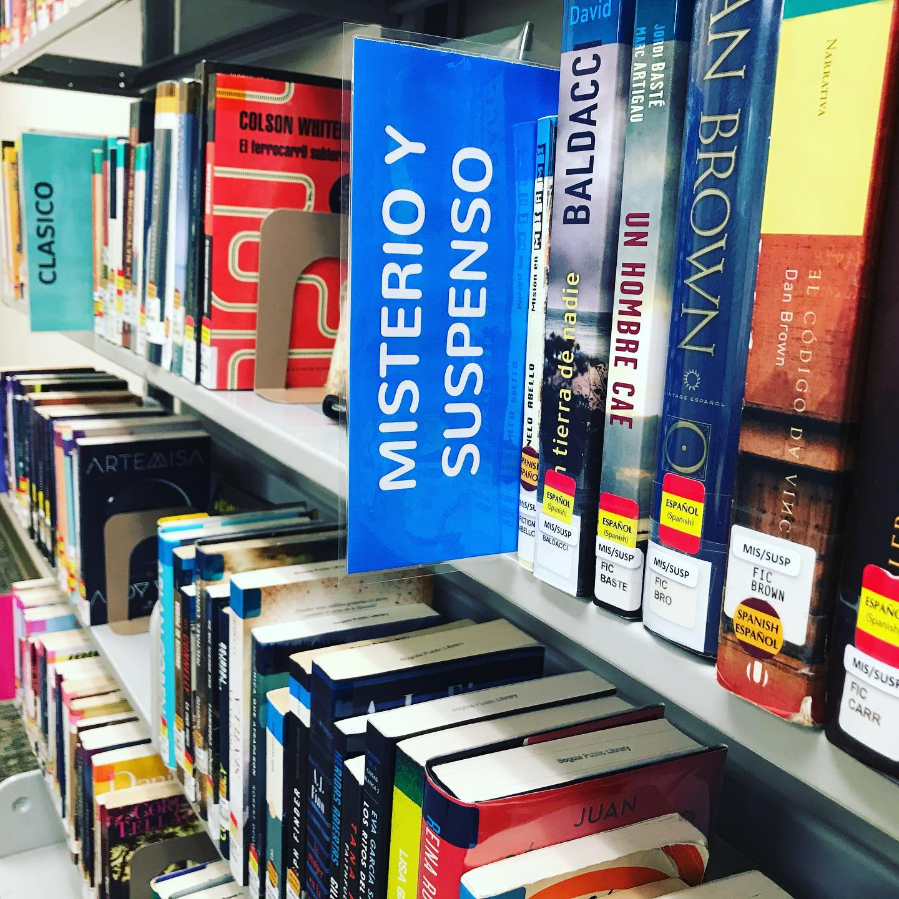
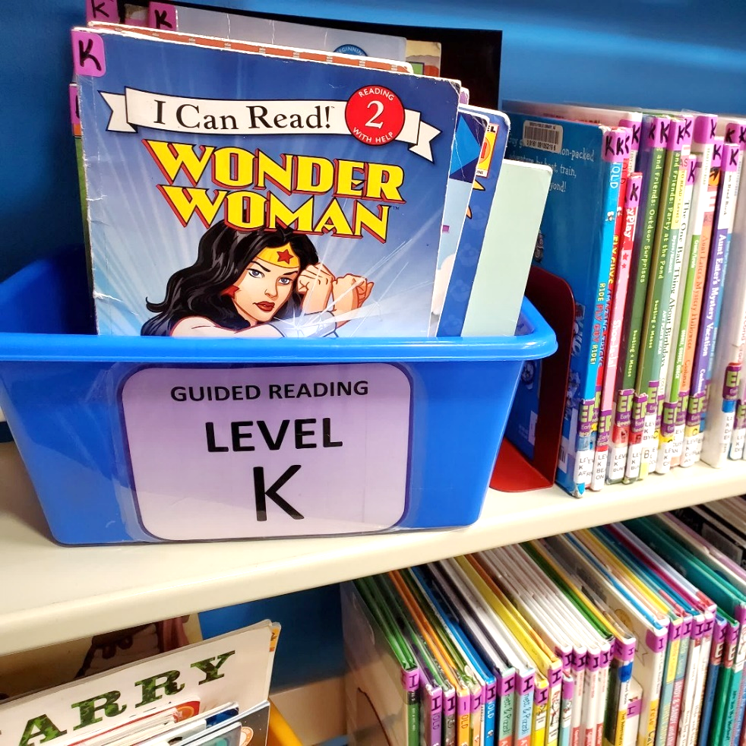
BROWSABLE COLLECTIONS
Notes:
11:20-11:25 (5 min)
A browsable or genrefied collection enables users to more easily stumble up on items of interest. The catalog can be used to locate specific things, but there's rarely a good way to have a good user experience "browsing" the catalog.
Some ditch Dewey in favor of BISAC; some simply use Dewey as the secondary classification; some do their own thing altogether!
Libraries find that circ goes up after "genrefying" because the collection is now user-centric.
ConC has collected a variety of schema used by school and public libraries.
REFLECTION QUESTION: What was your "ah-ha" moment?

Slide 22
NON-ENGLISH COLLECTIONS
Does anyone on staff speak the language?
What countries/regions does your community hail from?
Same selection tips apply.
Don’t forget to promote!
Notes:
11:25-11:30 (5 min)
Example: Not all Spanish-speakers use the same slang: El bicho enamorado boardbook
Consider attending book fairs, some of which you can get funding to attend.
World Languages Facebook group
Make sure to promote collection the same way you promote your English books. No one will check books out if they don't know they're there, or if the patrons come from countries where public libraries aren't free.
REFLECTION QUESTION: What barriers might you run into when trying to develop a non-English or other new collection?

Slide 23
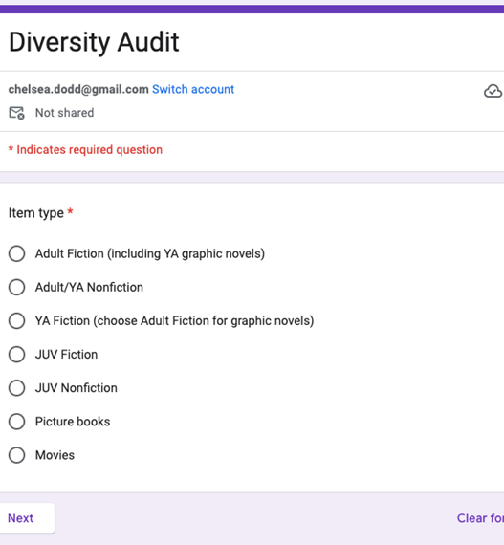
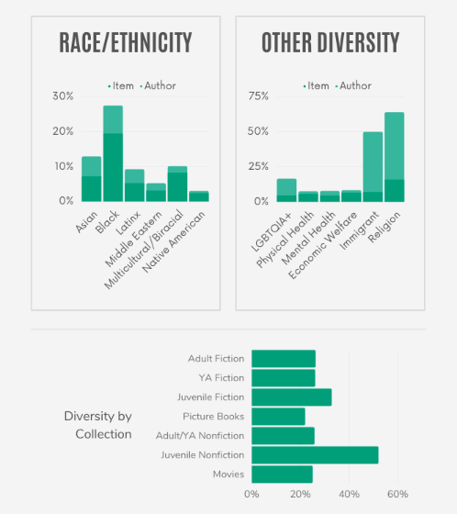
DIVERSITY AUDITS
Notes:
11:30-11:35 (5 min)
A diversity audit analyzes the variety of items in your collection. It considers author and character demographics and perspectives.
Even if your community isn't diverse, it doesn't mean your collection shouldn't be.
For those without access to CollectionHQ or other fancy software, manual audits can be done.
Thorough diversity audits gather multiple data points: book cover, book jacket description, catalog metadata...the places that demonstrate the characteristics of an item.
REFLECTION QUESTION: What actions will you commit to?

Slide 24
STAYING ON BUDGET
Do you have separate budget lines?
Do you purchase in waves?
How do you coordinate if other staff members also purchase?
Explore discounted rates.
Notes:
11:35-11:40 (5 min)
Encumbered vs. expended
CLiC Cooperative purchasing
REFLECTION QUESTION: What did you learn or re-learn?

Slide 25
Share one new insight or one idea that you’ll use.
Notes:
11:40-11:45 (5 min)

Slide 26
Connecting. Energizing. Inspiring. Services for libraries throughout Colorado.
Notes:
Lingering thoughts?
We’ll wrap up today the way we often do: with this reminder about our mission at CLiC.

