Slide 1







Mobile Services
Presented by:
Lynde McCaleb, Outreach Librarian, She/Her/Hers
Megan Lowery, Mobile Services Supervisor, She/Her/Hers

Slide 2

Agenda:
HPLD fleet (overview)
Selecting a vehicle (the right vehicle for the job)
Staffing
Collection Development & Stocking
RFPs and vehicle construction (the process)
Maintenance and Repair
Driver training
Safety considerations (on the road)

Slide 3

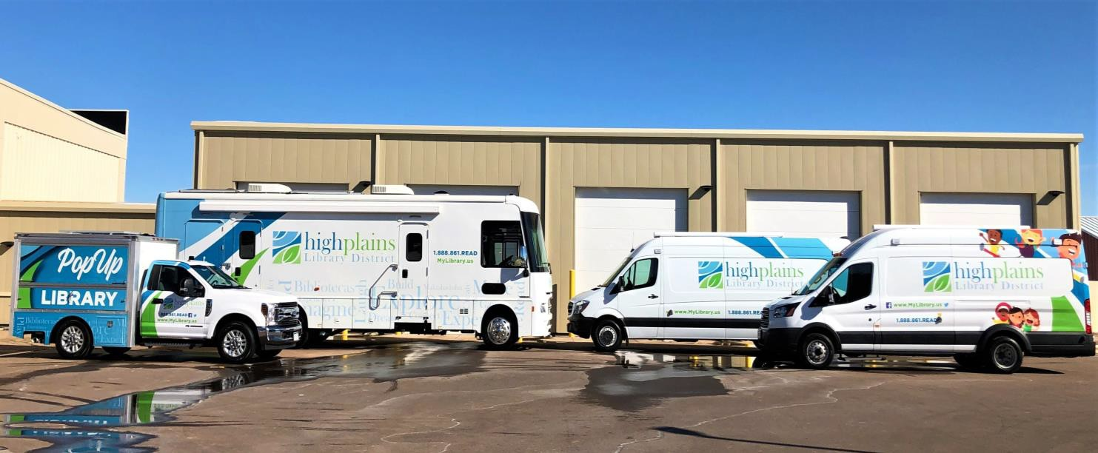
Overview of vehicles in our fleet
Bookmobile
Early Literacy Vehicle
Lobby Stop Vehicle
PopUp Experience Library

Slide 4
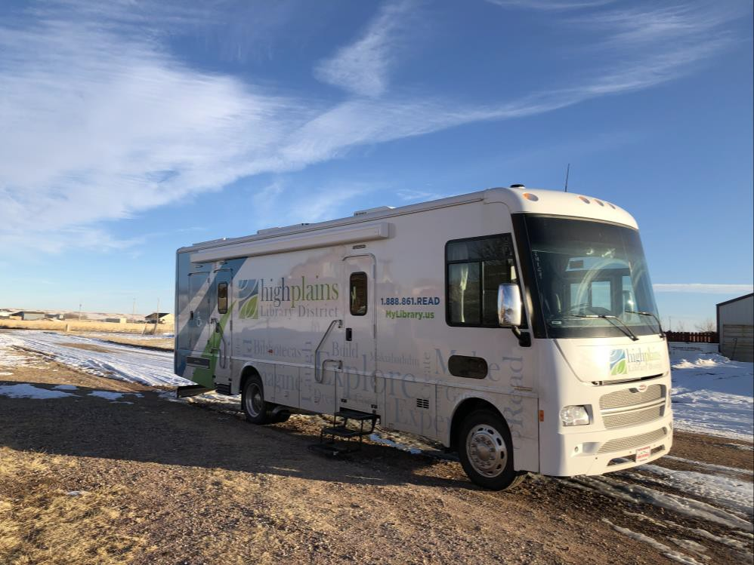

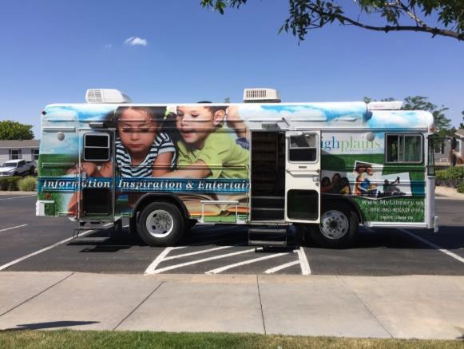
Bookmobile
Service Areas:
  Rural communities
  Underserved city neighborhoods
  Schools
  Moving to new service model
Type of Service
  Boarded vehicle
  Public Computers
  Public Printing
  Public Wifi
  On/Off Vehicle Programs and Storytimes
  Material Checkouts
    Regular materials
    Specialty Checkouts

Slide 5

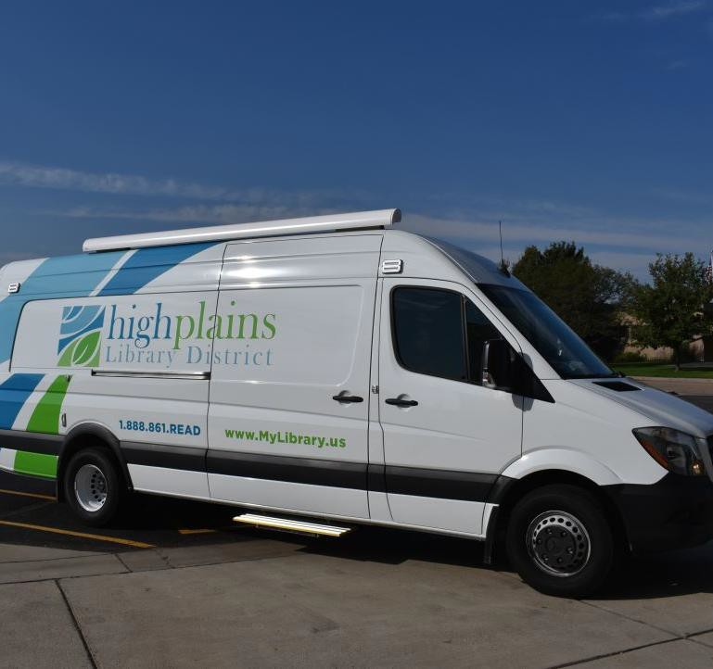
Sprinter Van
Lobby stops
Cart service
Priority Populations:
  Seniors
  Transitional

Slide 6
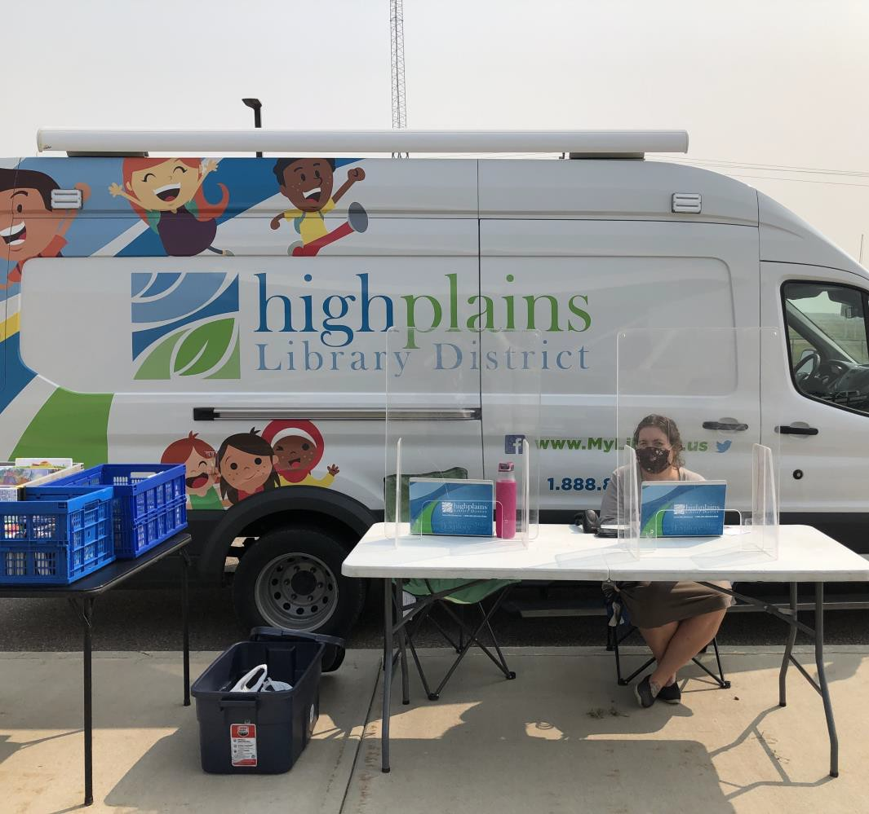
Transit Van
Early Literacy
Colorado Early Education Network (Headstarts)
  Cart service
Other regular routes & back-up
Summer stops

Slide 7
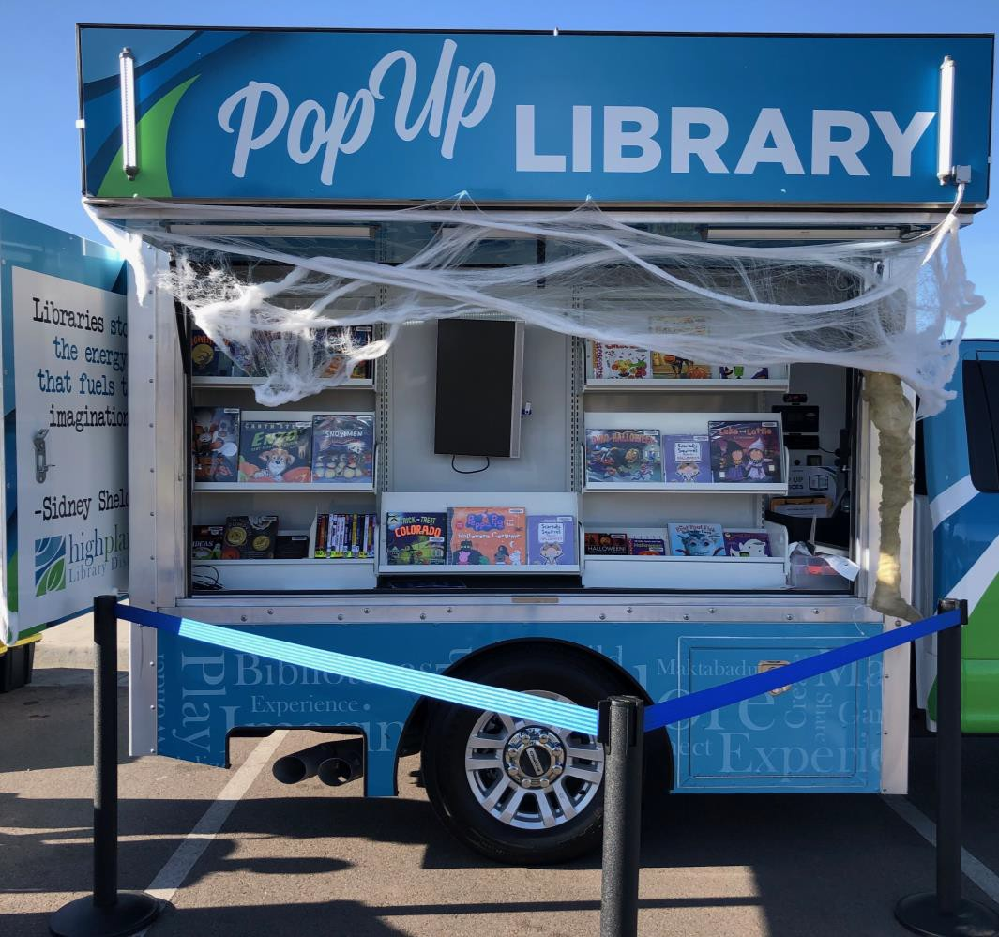

PopUp Vehicle
Events & Community Requests
  Outdoor Storytimes
  Food & Flick Fridays
  Multicultural Festival
  Monster Day
  Many more
Summer Programs
International Neighborhood Houston Gardens SRA
IRC Food Distribution
Union Colony Summer School
Home delivery

Slide 8
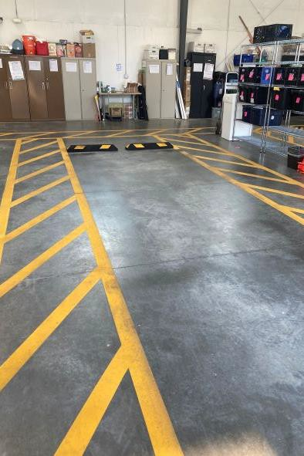
Housing your vehicles
Weather protection
Adding in
bumpers/guiding lines
Shorelines

Slide 9

Staffing
What kind of staff do you need/want for mobile services?
Positions/pay
Safety (always have two staff members)
Experience/Skills
  Ability to drive
  Ability to lift/carry items, if needed
  Responsibility/ dependability
  Attention to detail
  Patron-centered
Job requirements
  Will staff be responsible
for vehicle maintenance?

Slide 10

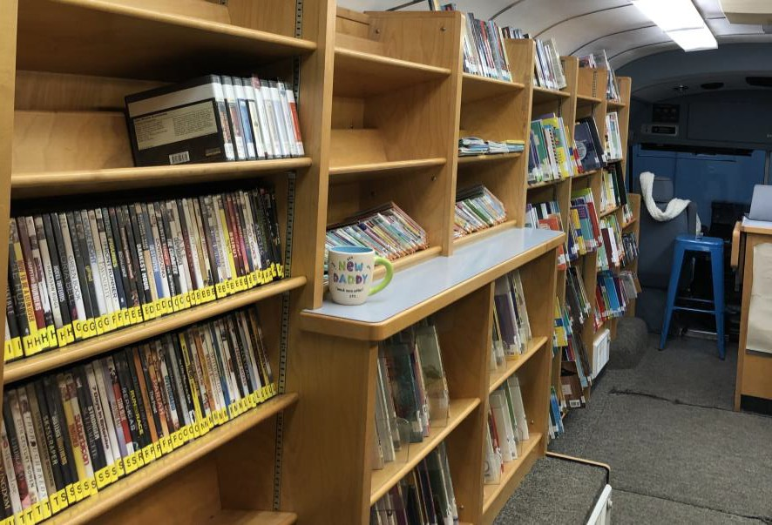

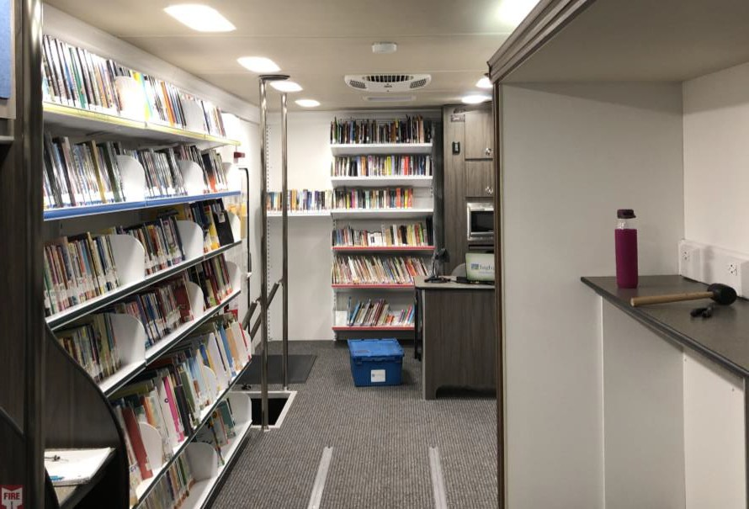
Collection Development
New materials on vehicles
Rotate materials from vehicles
Audience
  Seniors
  Community/public stops
  Schools
  Early Literacy
Shared/Floating Collection vs. Individual Collection

Slide 11


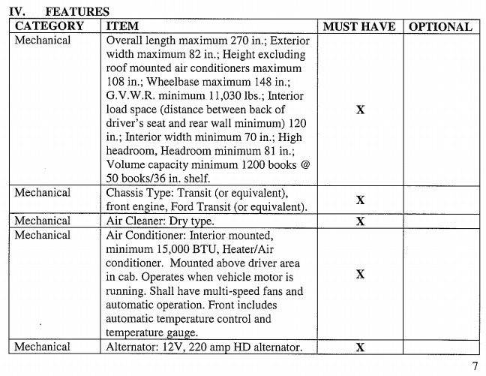



RFPs
What is the purpose of the vehicle?
What features are required and what features are optional?
Commercial Driver's License (CDL)?
Local options?

Slide 12

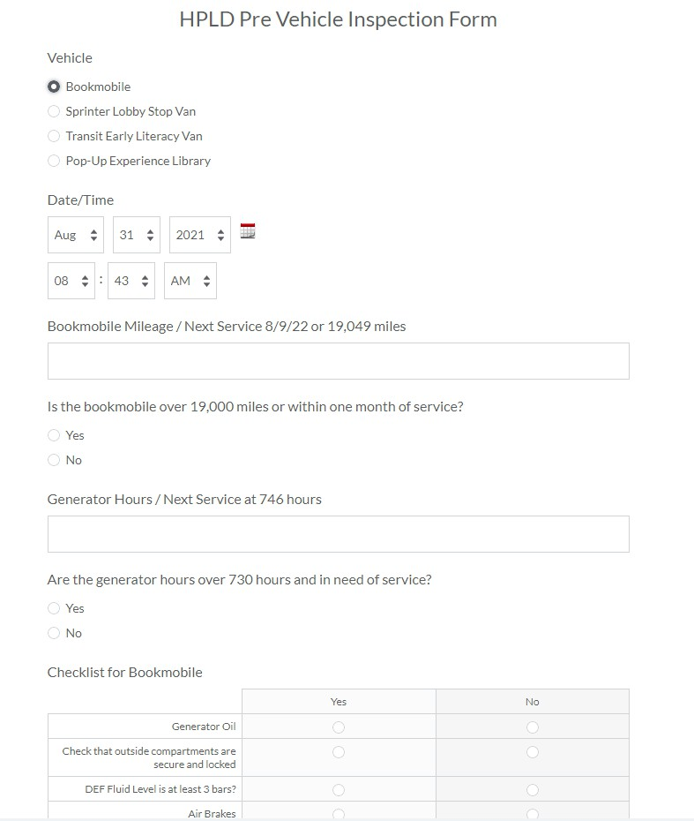
Maintenance & Repair
Pre & Post Inspections
Weekly walk-throughs

Slide 13

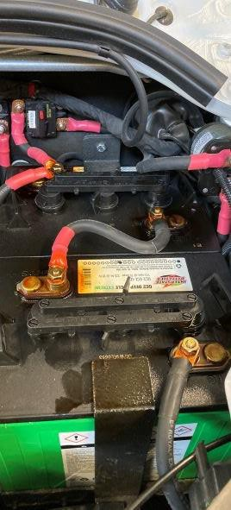
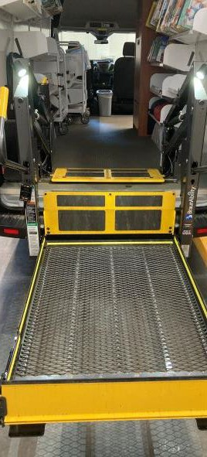
Regularly
Scheduled Maintenance
  Oil changes
  Generator
  Lift maintenance
  Sprinter: Battery

Slide 14
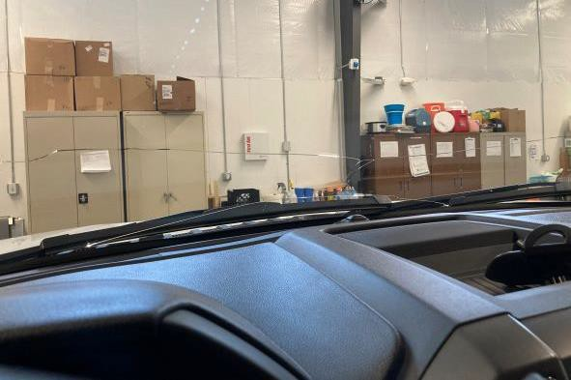
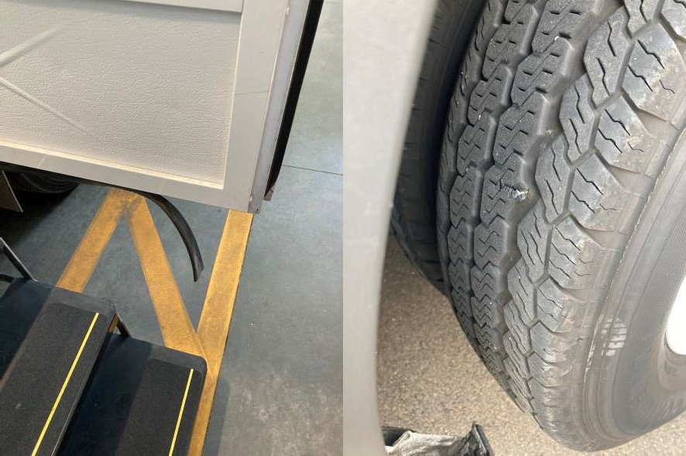
Maintenance & Repair
Repairs:
  Insurance
  Warranty Work
  Upfitting Work
  General Repair
    In house repairs vs shop repairs
  Windshields

Slide 15

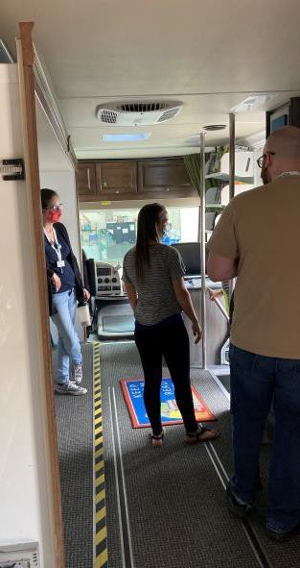
Vehicle Training
Driver Requirements
  Insurance Coverage
  Special Licenses (CDL)?
Driving Training
  In-House or contracted
Vehicle Maintenance and Care
Emergency Training/what to do in event of accident or breakdown

Slide 16

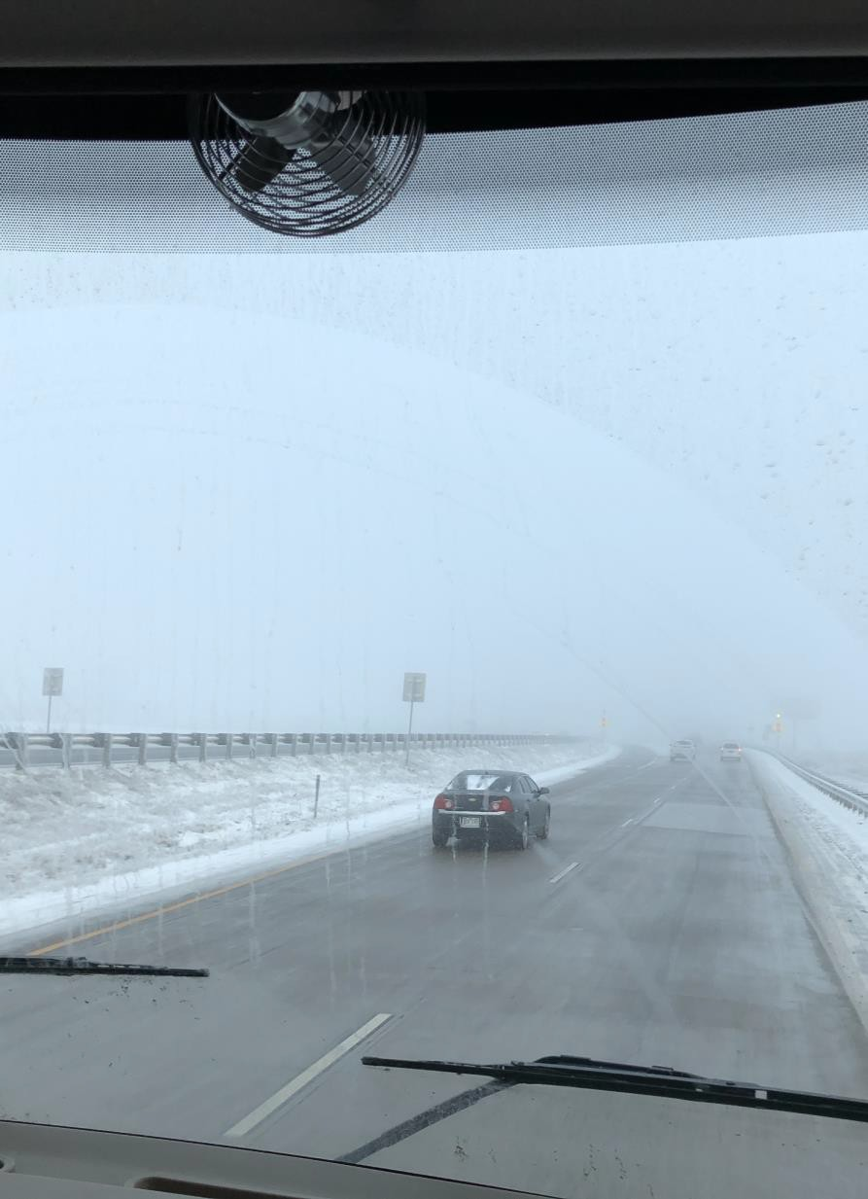
Vehicle Safety
Inclement weather
Accidents
Driving safety
Emergencies
  Medical
  Fire
  Accidents
  Weather-related
  Active shooter
  Harassment/threatening
behavior
Safety/Emergency materials to keep stocked

Slide 17

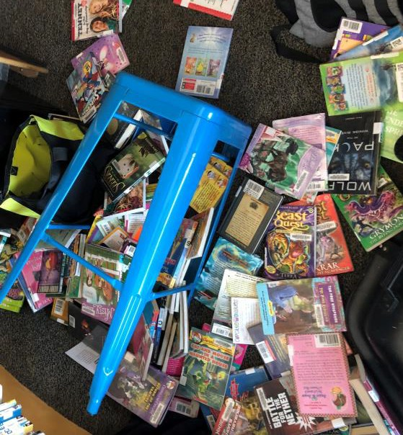
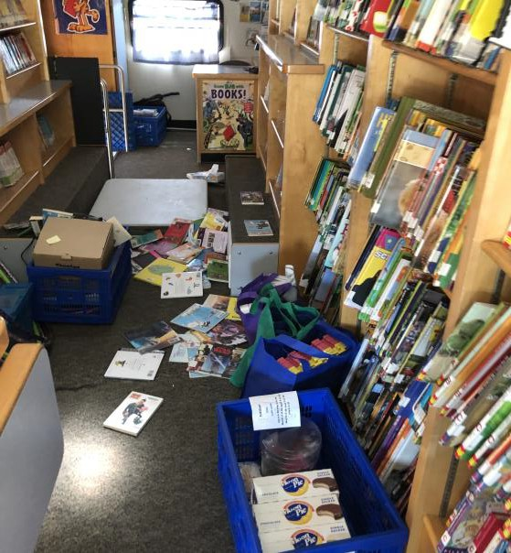
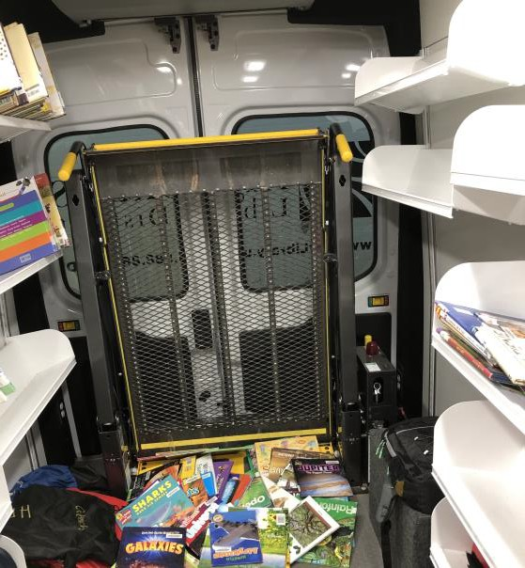
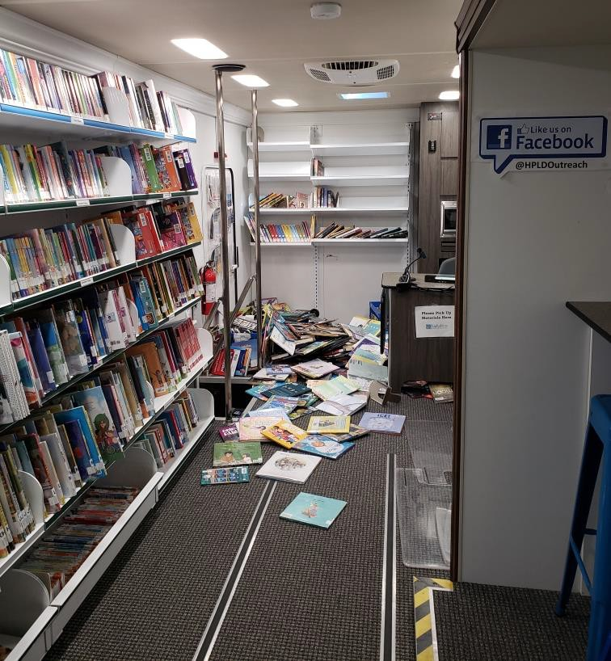
The Inevitable
It's always important to keep a good attitude and humor on the road. You never know what may happen, but the best that you can do is adapt to the situation and don't get frustrated.

Slide 18

Questions?

Slide 19
Contact Us!
Megan Lowery
Mobile Services Supervisor
mlowery@highplains.us
Lynde McCaleb Outreach Librarian lmccaleb@highplains.us

Slide 20


What’s Coming Up
Outreach Services, September 21st
Virtual Services, September 28th
Events Services, Community Conversations and Feedback Loop, October 5th
Community Partnerships, October 12th
Collecting Data in Outreach and Community Assessment, October 19th
Outreach Advocacy, October 26th

