Slide 1

Outreach Advocacy
Matt Hortt, Executive Director, He/Him/His
Rick Medrano, Patron Services Supervisor, He/Him/His
Rosa Granado, Associate Director of Public Services, She/Her/Hers

Slide 2



Objectives
for this training:
What is advocacy
Why is advocacy important
Types of
advocacy
Examples of
advocacy

Slide 3

AASL:
Process that builds partnerships
to turn passive support into educated action in support of libraries
What is Advocacy
PLA:
Process of acting to increase public funds and ensure resources needed for the critical success of libraries
Outreach Librarianship:
Focuses on the success of Outreach Librarianship

Slide 4

Why is Outreach Advocacy so important?
Outreach typically:
Is an afterthought
  Underfunded
  Understaffed
Serves underserved patrons/patrons facing barriers to service
Is not largely understood

Slide 5



Professional Advocacy
No formal definition
No best practices
No education
Not many professional developmental opportunities
Misunderstanding & lack of knowledge = lack of funding, staffing, and support
Outreach:

Slide 6
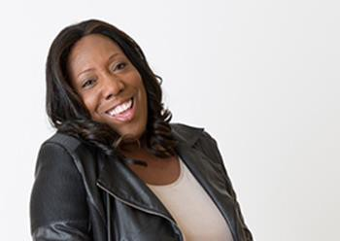

Professional Advocacy Continued
Outreach Librarianship Course (MLS)
Queens College
  Kim McNeil-Capers
Association of Bookmobile and Outreach Services

Slide 7

Advocacy for Funding?
Municipal/District
Budget Presentations Public Comment
Grantors
Defined Need Expanded Reach
Connector

Slide 8

External
Community members
Users and non-users
Community Partners
Other Libraries
Internal
Staff
Administration
Board
Organizational leadership
Organizational Advocacy: Internal vs External
Two-way street
Internal stakeholders are just as important as
external
Buy-in
Strategic Development
Communication is key

Slide 9


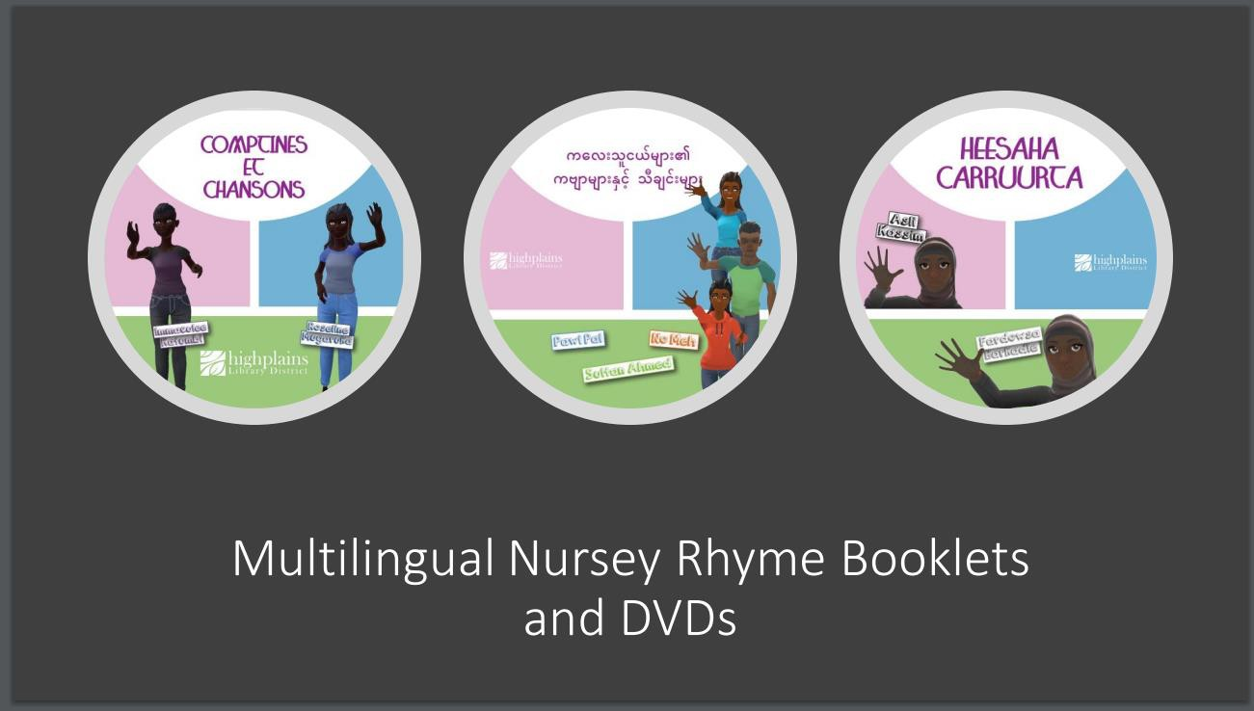
Organizational Advocacy: Library Boards and Admin
Misconceptions
  Library Service not marketing
  Unclear on barriers to access
  Not every staff member is the right one for outreach
Advocacy
  Helping Build Community
  Outputs vs Outcomes
  Success Stories
  Public Comment from Underserved Populations
  Formal requests for service
  Board and Interests

Slide 10




Community Advocacy
Identify your community
Understand your community
Community Assessment or
review your data
Where do your users live/not live
How do people learn about the library?
How can you increase your communication?
Advocate!
Be active
Users and non-users
Consider organizational partnerships
Elevator speeches Stickers/branded materials
Swag and information
The worst pitfall: getting critical community feedback and doing nothing to remedy the issues
Letting the momentum stagnate

Slide 11


Advocating for our Patrons
The challenges of outreach
Underserved populations and barriers
More time More money
More skills needed
Our patrons deserve access to library resources
Strive to balance inputs with outcomes
Internal advocacy is especially important here
Be receptive to their needs, not your offerings

Slide 12

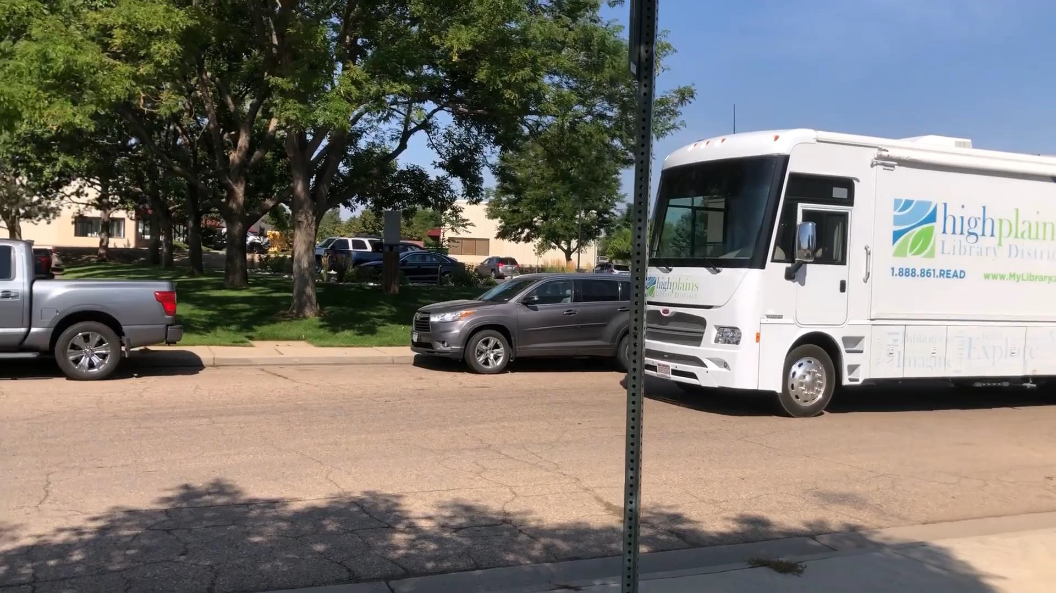
Community Advocacy Continued

Slide 13
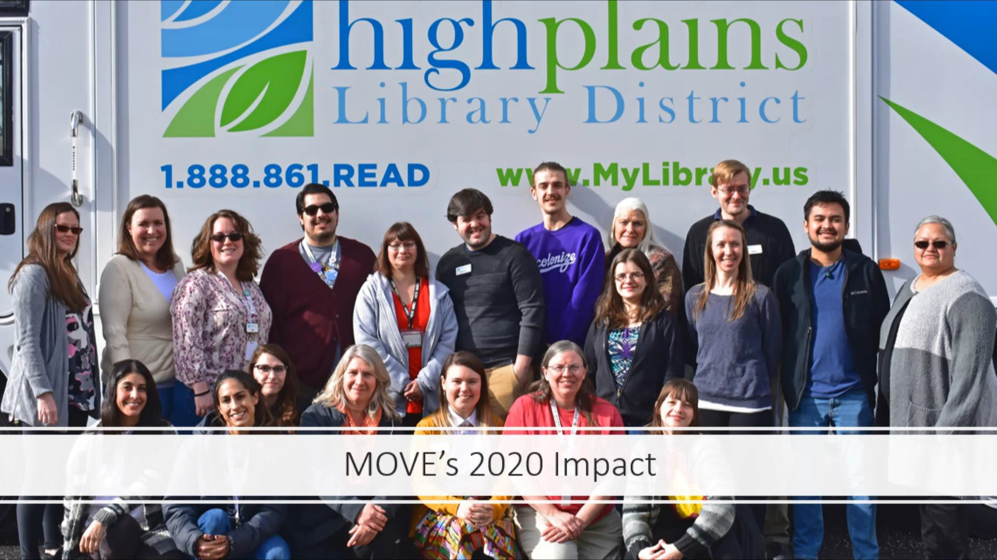
MOVE 2020 Impact Video

Slide 14
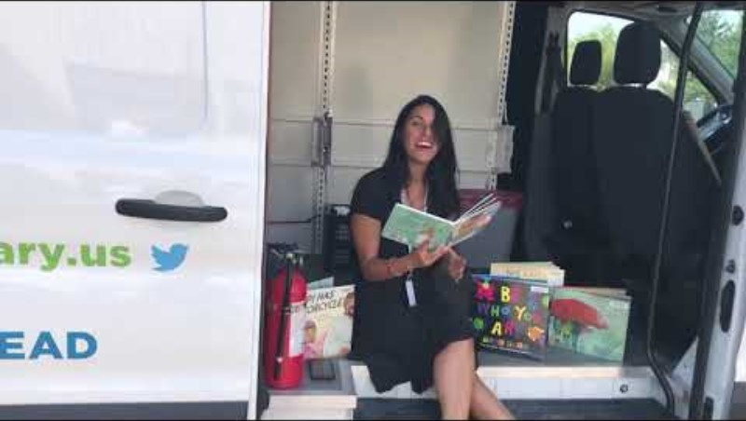
HPLD State Lobby Day Video

Slide 15
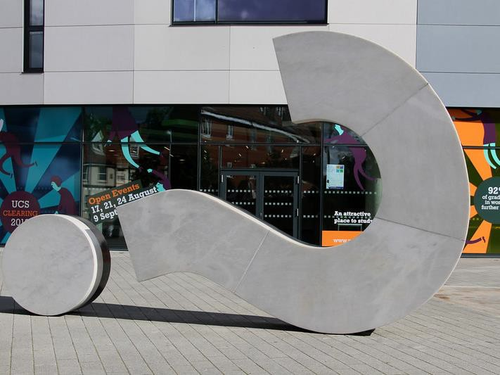


Questions?

Slide 16

Contact Us!
Matt Hortt Executive Director
mhortt@highplains.us
Rick Medrano Patron Services Supervisor rmedrano@highplains.us
Rosa M. Granado Associate Director of Public
Services/MOVE rgranado@highplains.us

Slide 17


Previously Recorded:
Outreach Foundations, September 7th
Mobile Services, September 14th Outreach Services, September 21st
Virtual Services, September 28th
Events Services, Community Conversations and Feedback Loop, October 5th
Community Partnerships
Collecting Data in Outreach and Community Assessment, October 19th

