Slide 1



Community Partnerships
Carolyn Valencia, Outreach Librarian, She/Her/Hers
Elena Rosenfeld, Community Engagement and Strategies Manager, She/Her/Hers Rosa Granado, Associate Direct of Public Services/MOVE, She/Her/Hers

Slide 2


Objectives for this Training
Why partnerships
Establishing partnerships
Growing partnerships
Prioritizing partnerships
Evaluating partnerships
Ending partnerships

Slide 3
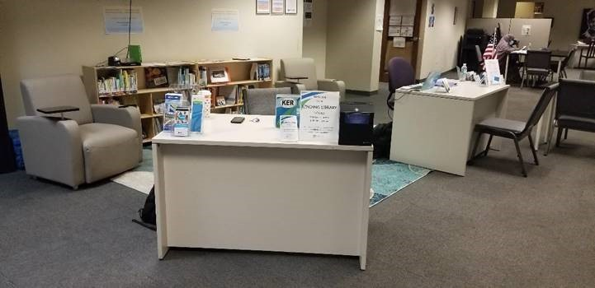
Why Partnerships?
Access
More resources
Vested in communities
Organizational trust
Allows us to use library skills
Saves us time
Ends duplication

Slide 4

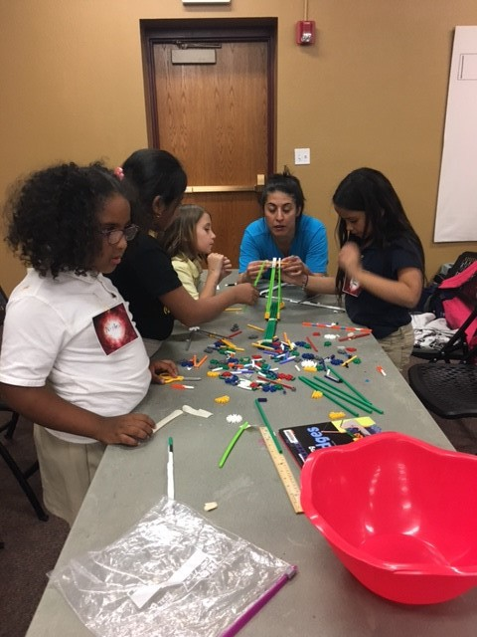
Establishing Partnerships
Defining partnerships
Different types of partnership
Where do we find them
Exceptions

Slide 5

Establishing Partnerships - Tools
Create tools
Library mission, goals, objectives
Departmental goals and objectives
Impact on patrons
Impact on staff
Cost
  Staffing
  Vehicles
  Resources

Slide 6

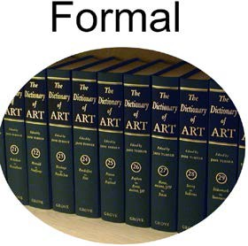
Growing Partnerships
HOW FORMAL DO WE NEED IT TO BE?
Informal
Budget and/or Time commitment is smaller
Usually scheduled as single appointments rather than ongoing
May lead to an ongoing partnership, but it isn't there yet
Semi-formal
Ongoing collaboration but nothing stipulated in writing
Unwritten agreements or shared guidelines
Paid one-time event
Formal
Budget and or Time commitment is more significant
Written agreement is in place (MOA, IGA, or MOU)
Images cc attribution: Arbek's Informal vs Formal Knowledge Repository for WikiMedia

Slide 7

Prioritizing Partnerships
What are the reasons for this partnership?
How does it support your library's priorities? What level of priority?
Are both organizations getting value from it? How do you know?
What are the expected results of this partnership?
How does it help you achieve your goals? How do you know?
How does it increase your visibility? To whom?
What are the costs of this partnership?
Is the time, effort, and money spent worth it?
What could you be doing instead?

Slide 8

How Do You Evaluate?
Use your tools
Objective
Reliabe
Fair
Outputs versus Outcomes

Slide 9

Deciding to Move to New Opportunities
When is it time to say "goodbye" to a partnership?
Are you still partnering because it's tradition?
Are your priorities still in alignment?
Can you clearly identify what is (or isn't) working?
Can We Still Be Friends?
Be open to new and future opportunities.
Consider whether there are different ways to work together.
Find ways to check-in and see what is happening on an ongoing basis.
Picture of Cow Eating Grass by Ernie

Slide 10
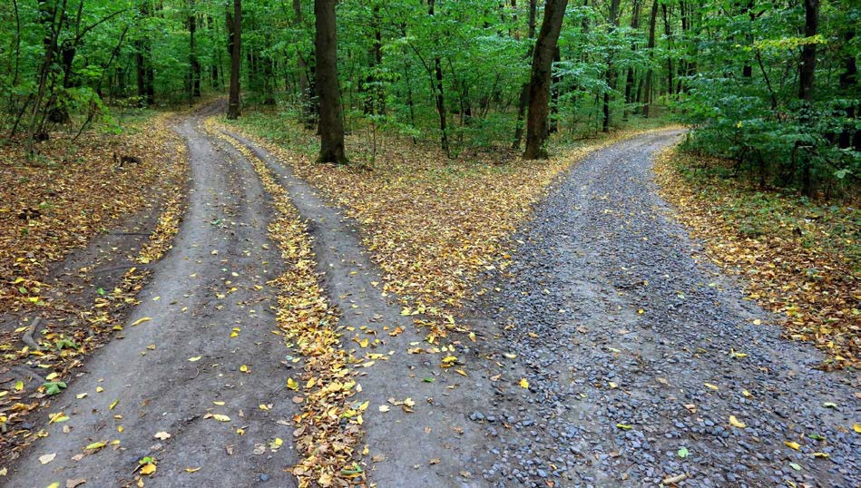
Ending Partnerships
Assess
We care, how do we balance our
personal and emotional with profession – use the tools. They
are objective.
Honest communication
Open door

Slide 11

Questions?

Slide 12

Contact Us!
Carolyn Valencia Outreach Librarian cvalencia@highplains.us
Elena Rosenfeld Commnity Engagement and Strategies Manager erosenfeld@highplains.us
Rosa M. Granado Associate Director of Public
Services/MOVE rgranado@highplains.us

Slide 13


What’s Coming Up:
Collecting Data in Outreach and Community Assessment, October 19th
Outreach Advocacy, October 26th
Previously Recorded:
Outreach Foundations, September 7th
Mobile Services, September 14th Outreach Services, September 21st Virtual Services, September 28th
Events Services, Community Conversations and Feedback Loop, October 5th

