Slide 1

Event Services, Community Conversations and Feedback Loop
Presented By:
Brittany Raines, MOVE Manager, She/Her/Hers Carolyn Valencia, Outreach Librarian, She/Her/Hers
Elena Rosenfeld, Community Engagement and Strategies Manager,
She/Her/Hers
Rick Medrano, Erie Patron Services Supervisor, He/Him/His

Slide 2

Objectives
Learn:
How we Manage our Event Services
Strategic Planning
Examples of our Community Conversations
Feedback Loop Functionality
Challenges

Slide 3
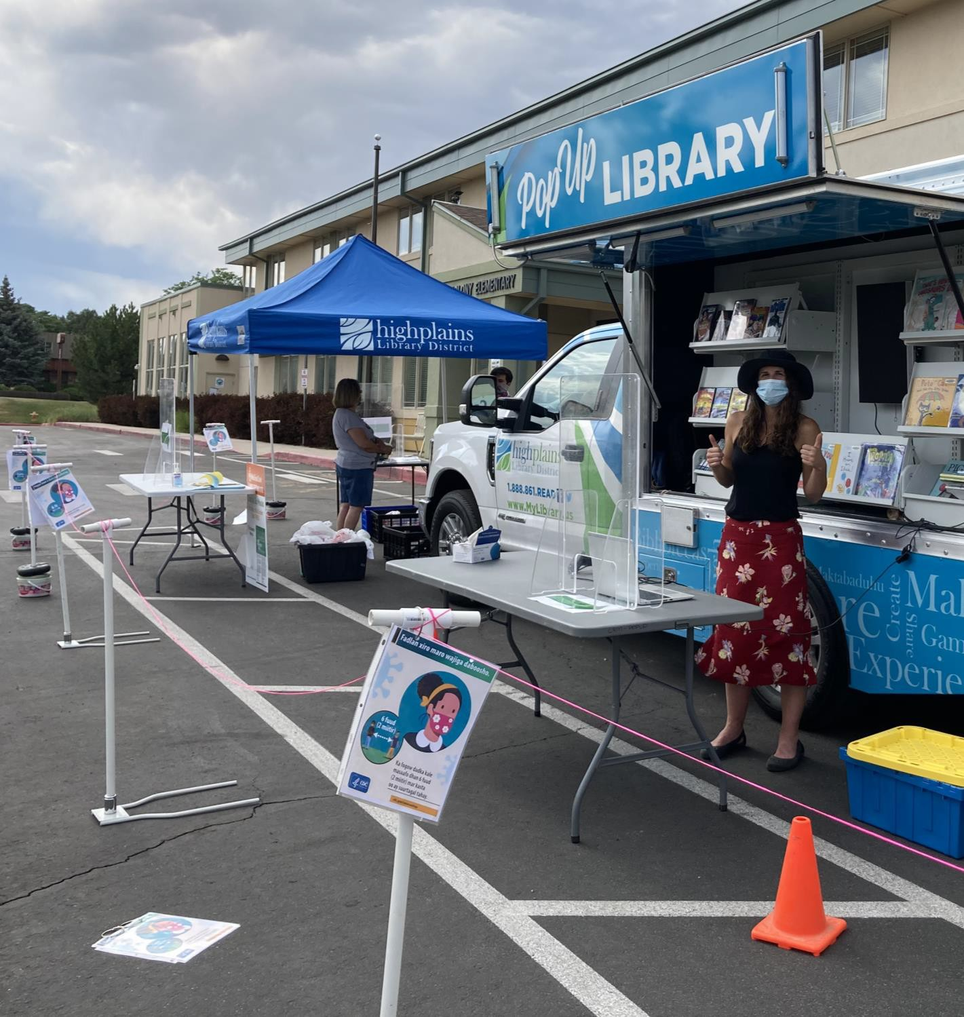

Requesting HPLD to attend events
Partner Agency Requests
Staff Requests

Slide 4
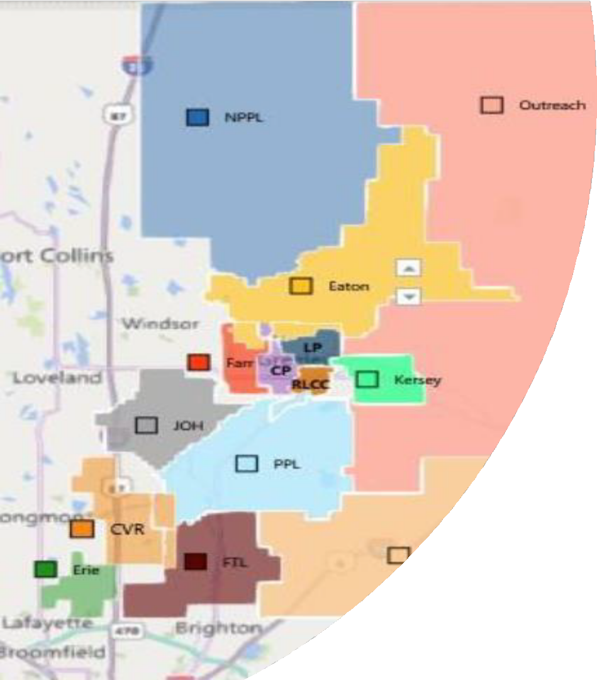
Accepting and Declining Requests
Primary Considerations
Staffing Availability
Priority Populations
Secondary Considerations
Service Area; Outreach, branch, members
Level of promotion

Slide 5

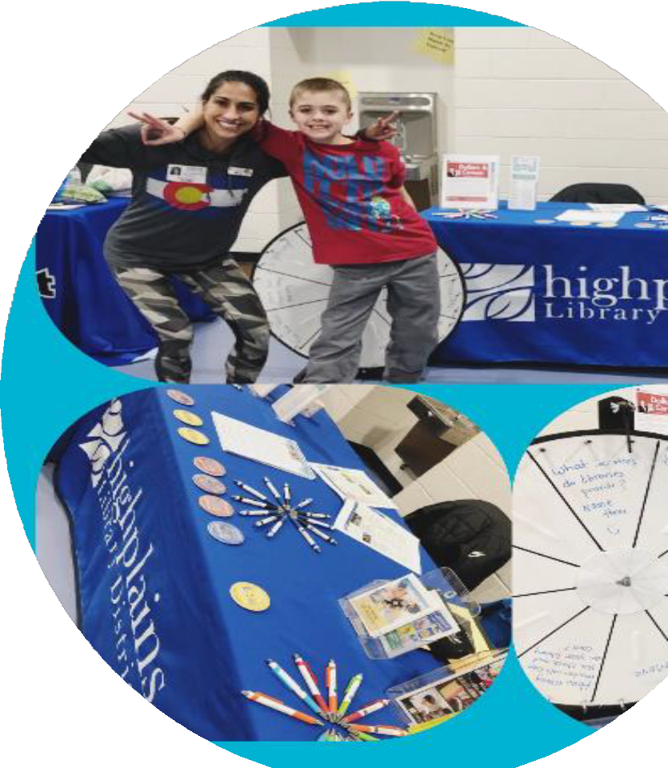
Staffing Events
District Wide vs. Single Service Area
Vehicle vs. Booth requests

Slide 6

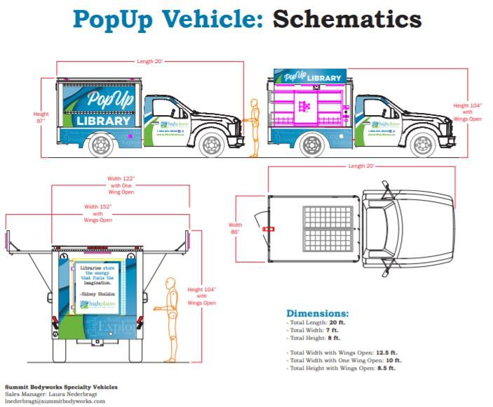
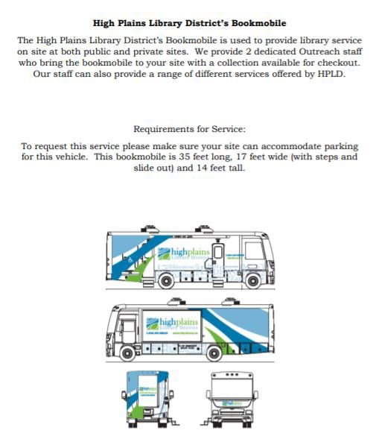
Vehicles for Request
PopUp Library
Bookmobile

Slide 7
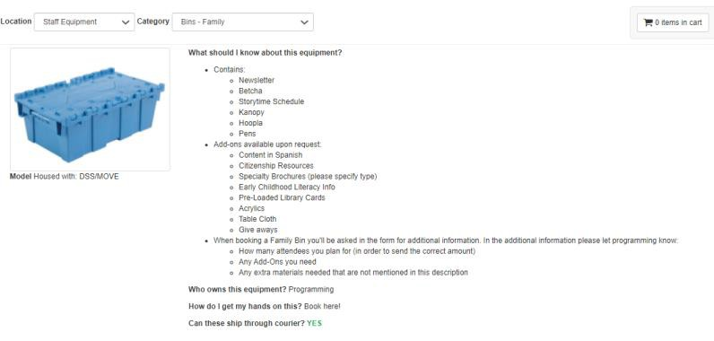
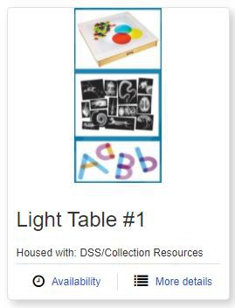
Event Preparation
Scheduling Vehicles
Planning Activities
Requesting Equipment and Promotional Material
Creating Intentional Feedback Loop Activity

Slide 8
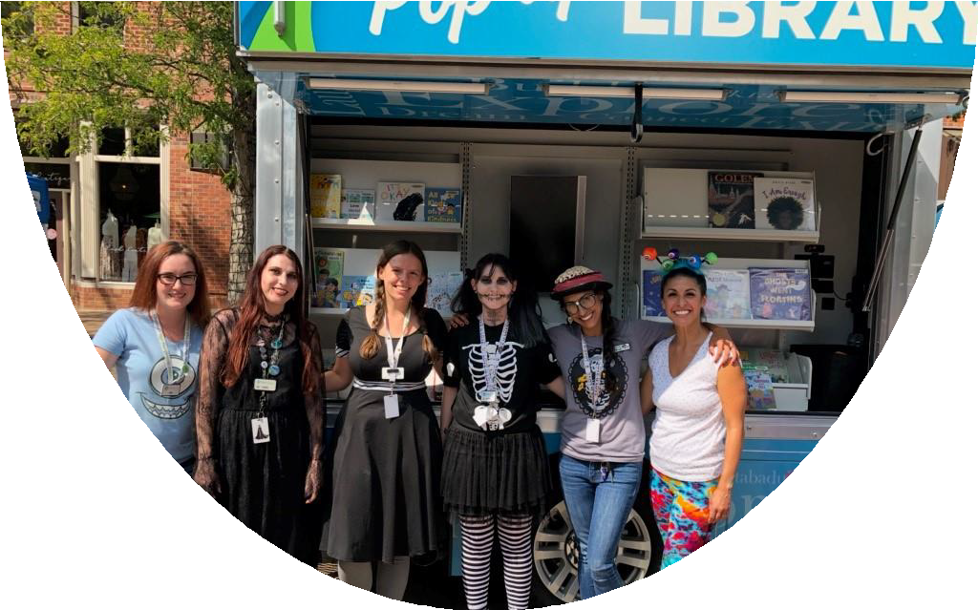
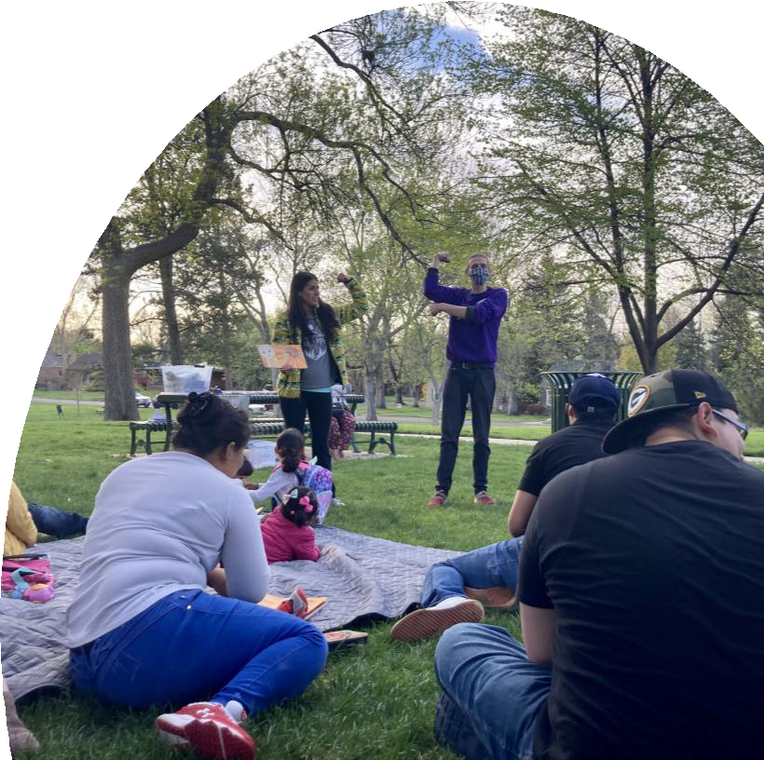
Types of Events
Single Service Area:
Evans Heritage Days
Miner’s Day
Mead Block Party
Grover Days
Touch-a-Truck
District Wide:
Martin Luther King Jr. Day
Monster Day
Cinco de Mayo
Greeley Pride
Weld Project Connect
Yes!Fest

Slide 9

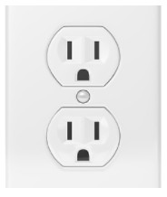
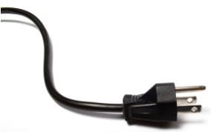
STRATEGY IN MAKING COMMUNITY CONNECTIONS
AKA the importance of thoughtful decision-making
We have limitations! - time, resources, money, etc
So, we need to make our best possible decisions using:
Assessment of how opportunities align with current priorities
Information we know through past experiences
Information we gather through our most recent efforts
Insights from community members
To try to make the best possible connections.

Slide 10


WANT TO KNOW WHAT IS WANTED AND NEEDED? ASK!
Community Conversations – AKA Going To the Source
BEFORE ASKING OTHERS, ASK YOURSELF
What do you want to learn?
How do you intend to use that information?
Who are the right people to ask?
How should you get that information?
Example: ProjectBUILD vs Yes!Fest Conversations

Slide 11



CHOOSING THE RIGHT PARTICIPANTS

Slide 12
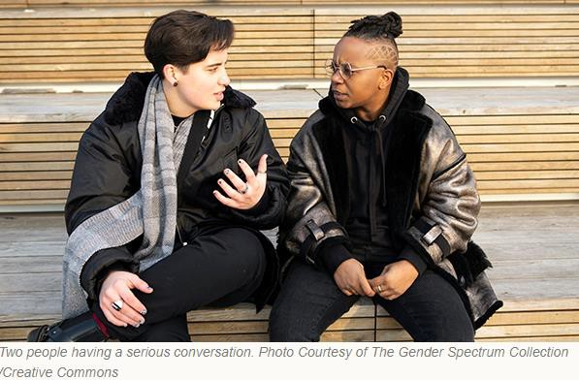
Getting Feedback
SO MANY OPTIONS ON HOW TO ASK
...and all of them present risks as well as opportunities
Surveys: wide distribution but will they respond?
Great for gathering ideas
Interviews: you catch the person but will they help?
Great for getting insights from individuals
Focus Groups: a great information source with intriguing challenges Great for identifying next steps challenges
and
And more: informal conversations

Slide 13

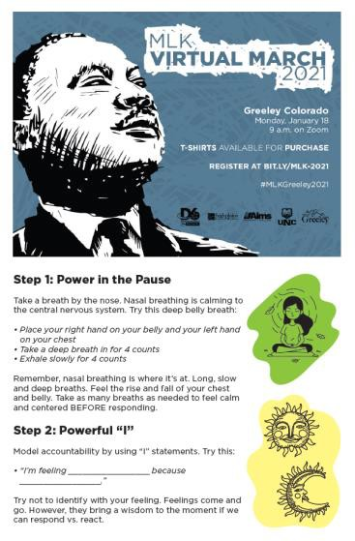
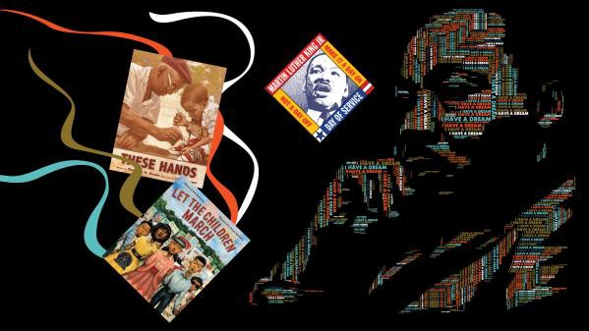

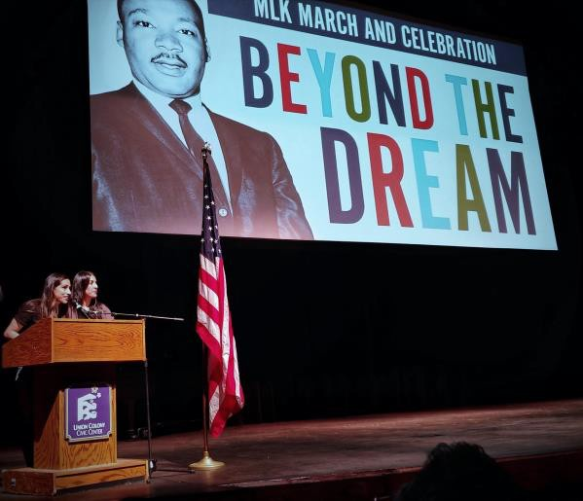
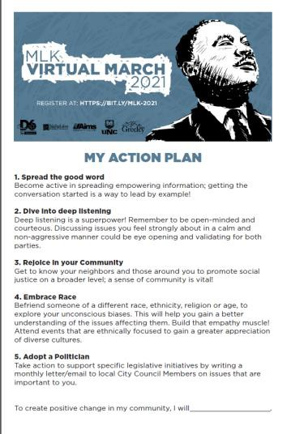
MLK March and Celebration
2019 - 2021

Slide 14
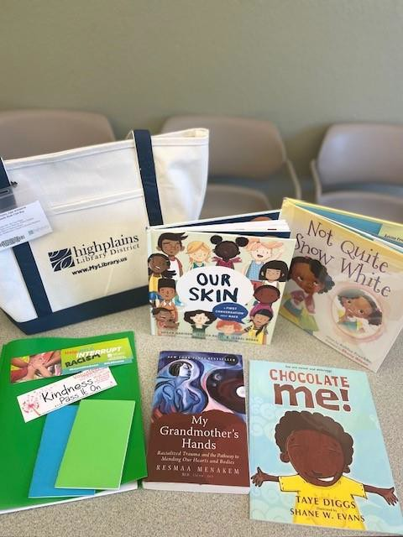
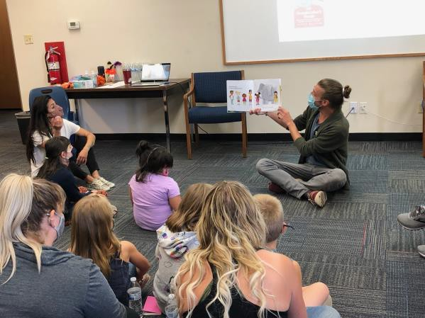

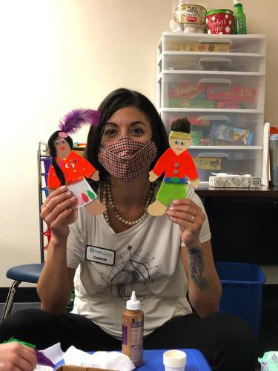
Widening the Window
Family Book Club

Slide 15


Feedback Loop
Purpose
Engaging the branches to give and receive feedback will improve both parties.
Negative feedback loop- improve services based on negative feedback and complaints
Positive feedback loop- improve services based on positive feedback and compliments
Ideally, we will be able to provide both kinds of feedback to the branches
The purpose of all feedback is to improve service
Photo by Jon Tyson from Upsplash

Slide 16

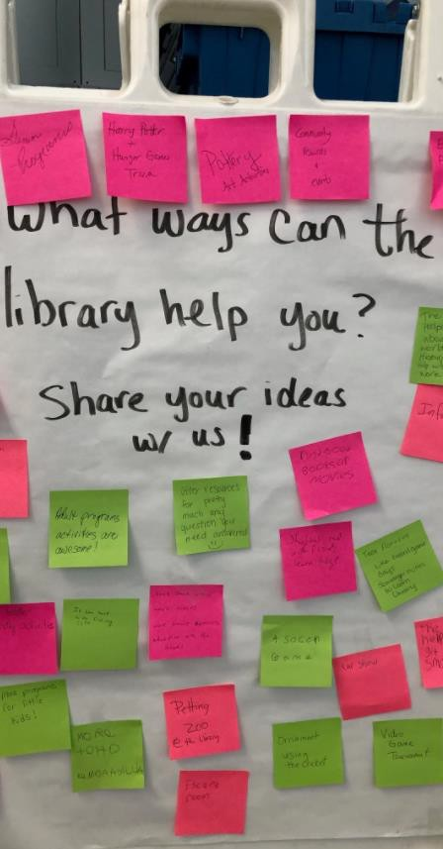
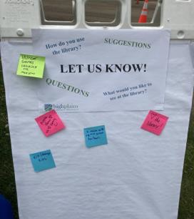
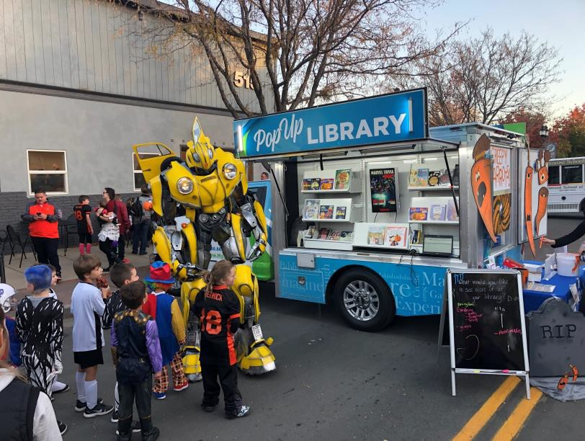
Collecting Data
Love seeing the PopUp in my neighborhood, Glenmere Park area.

Slide 17

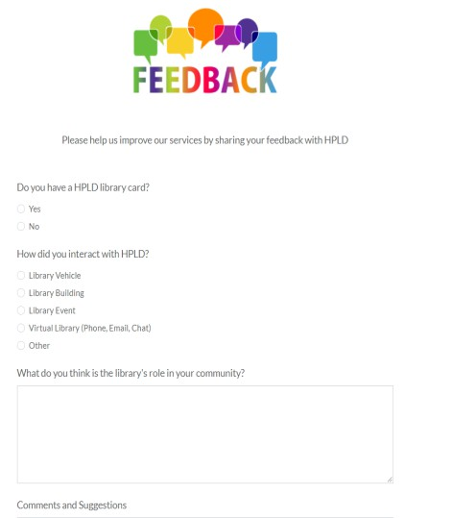
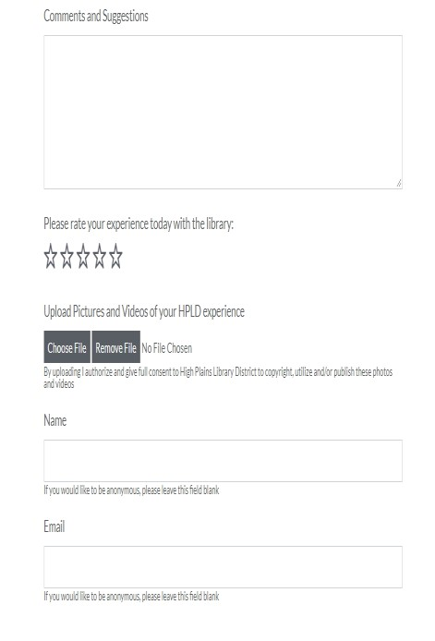
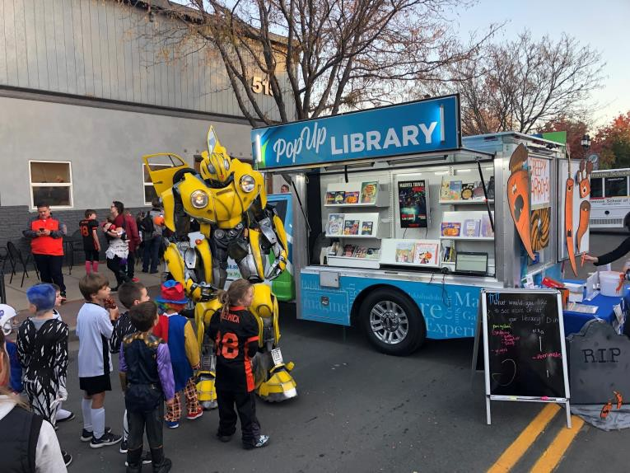

Feedback
Feedback Formstack

Slide 18
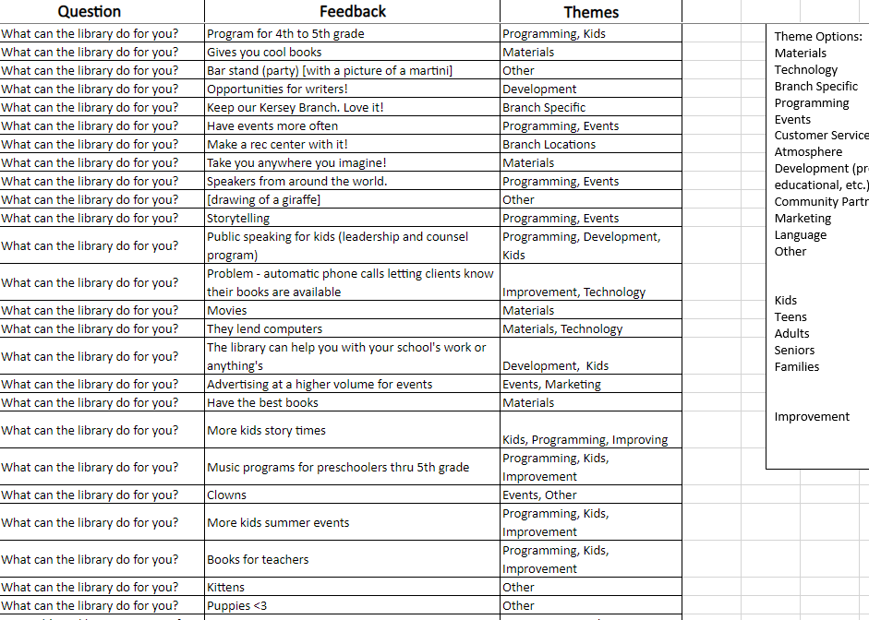
Analyzing and Coding Data
Current Codes for
Qualitative Data:
Staff Appreciation
Activities
Routes
Branch Feedback
Language
Programs
Materials
Technology

Slide 19
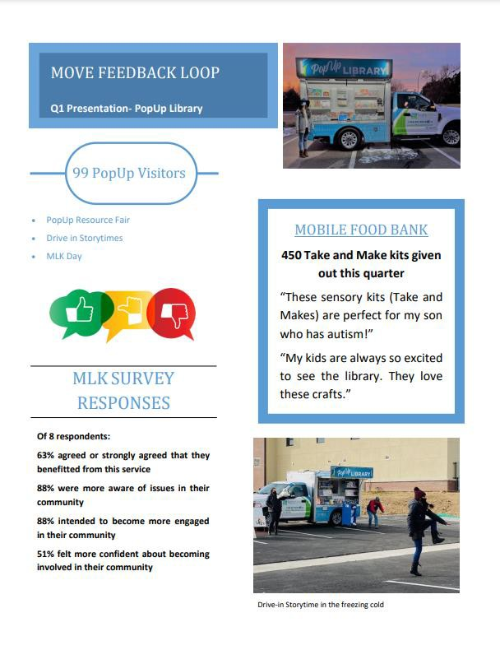
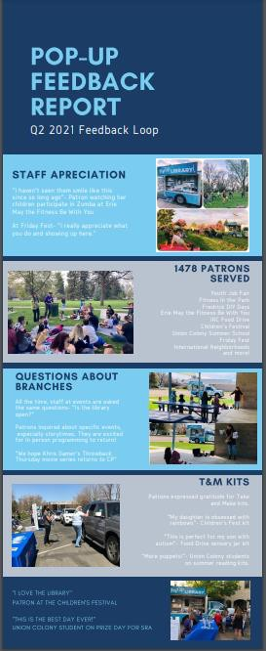
Publishing Quarterly Reports

Slide 20

Challenges
Collecting Data
Limited staff and busy
events
Getting patrons comfortable sharing feedback
Inclusion of languages beyond English and Spanish
Using it to Make Suggested Changes and Guide Next Steps
Photo by Eila Lifflander on Unsplash

Slide 21
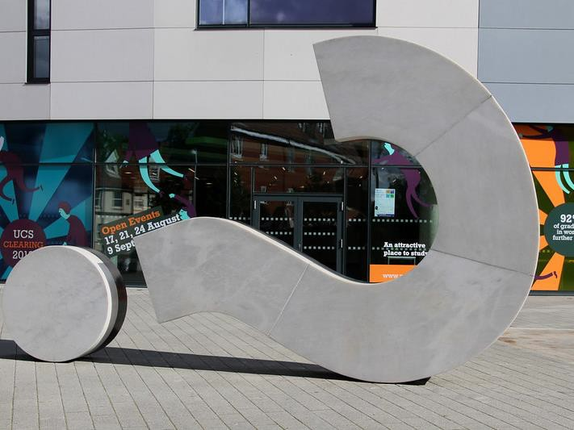


Questions?

Slide 22
Contact Us!
Brittany Raines MOVE Manager
braines@highplains.us
Elena Rosenfeld Community Engagement and Strategies Manager erosenfeld@highplains.us
Carolyn Valencia Outreach Librarian cvalencia@highplains.us
Rick Medrano Patron Services Supervisor
rmedrano@highplains.us

Slide 23


What’s Coming Up
Community Partnerships, October 12th
Collecting Data in Outreach and Community Assessment,
October 19th
Outreach Advocacy, October 26th
Previously Recorded:
Outreach Foundations, September 7th
Mobile Services, September 14th Outreach Services, September 21st Virtual Services, September 28th

