Slide 1



Collecting Data in Outreach and Community Assessment
Brittany Raines, MOVE Manager, She/Her/Hers
Megan Lowery, Mobile Services Supervisor, She/Her/Hers Rick Medrano, Erie Patron Services Supervisor, He/Him/His

Slide 2

Objectives
Learn:
Our Challenges in Data Collection
Importance of Community Assessment and the tools we use
How we collect data for decision making
How we build our data collection and evaluation tools
How we visualize our data
Why we value our data

Slide 3



Challenges of Data Collection
Staff training
Organizational structures
Twinkle baby kits and CEEN
evaluation
Automation vs manual data entry
Time consuming

Slide 4


Importance of Community Assessment: Adjusting to changing community demographics
Passive
Goal: Active

Slide 5

COMMUNITY ASSESSMENT TOOLS
Analytics on Demand
  Gale Analytics
  Tableau
Data Sources: Census Data, School Data, County Data
Community Request Form
Patron Feedback

Slide 6

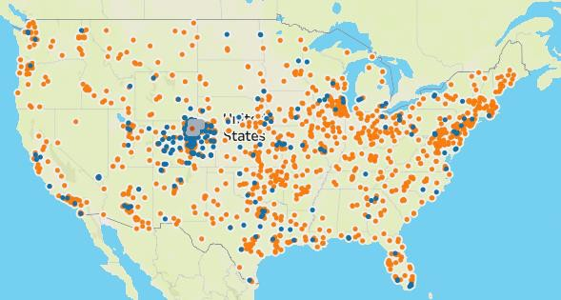
DATA SOURCES AND TOOLS
U.S. Census
  American Community Survey
Local Government data
Tableau
  Data Visualization Tool

Slide 7
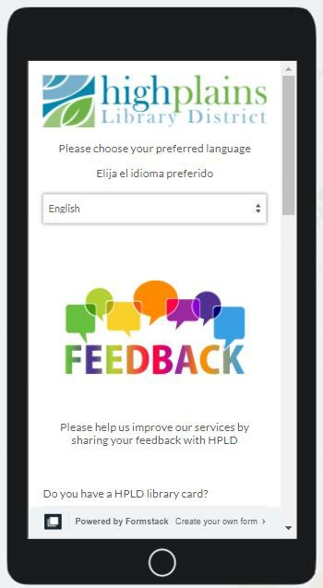
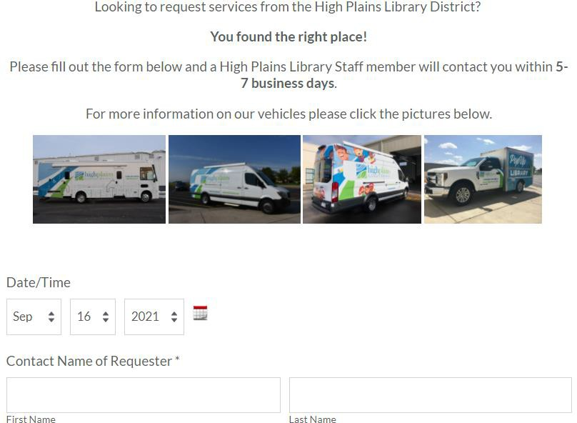


Outreach requests and feedback
Community
Request Form
Patron
Feedback

Slide 8
Data for Decision Making
Data for Decision Making
Examples:
Book deposits
CEEN
Measurements
Prioritizing data usage for making decisions at an organizational level
Developing measures to assess the success and impact of services
Great way to justify services that seem more challenging or for ROI
especially for time intensive projects

Slide 9

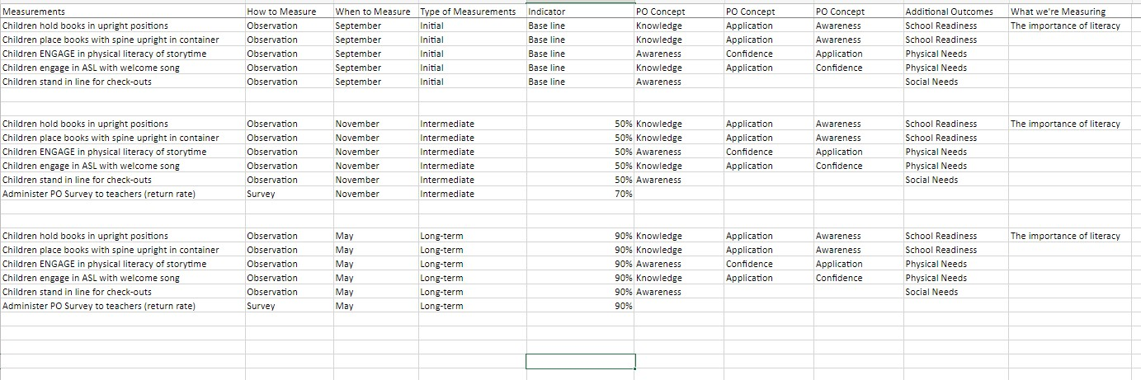
Measurements

Slide 10


Building Data Collection and Evaluation Tools
Consider how the data will be used prior to building tools
Public Library Annual Report
(PLAR)
Tracking Staff Time
Tracking Goals
Create evaluation measures and schedules

Slide 11

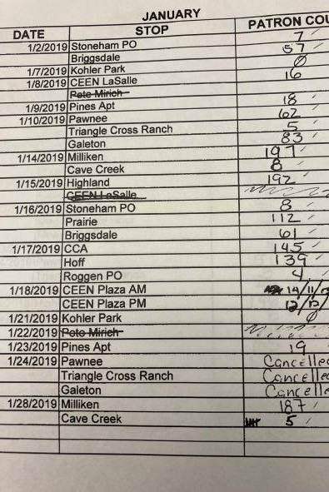

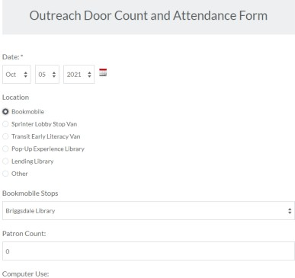
Data Collection Made Easy
Print vs. Digital Real time data
Free vs. paid options
IT assistance

Slide 12
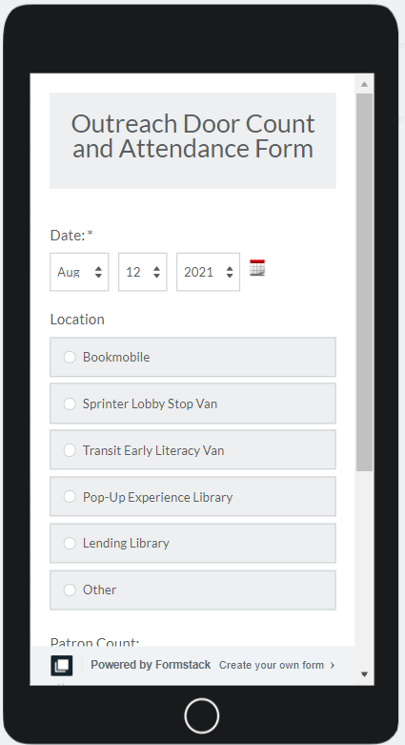
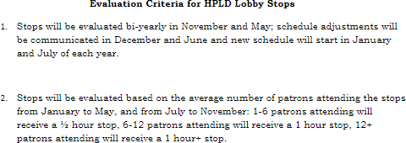

Example Tools
Door Counts
  LS MOU
  District Master Stats
BALs
  Track time and topic for all direct assistance that lasts more than 15 minutes

Slide 13
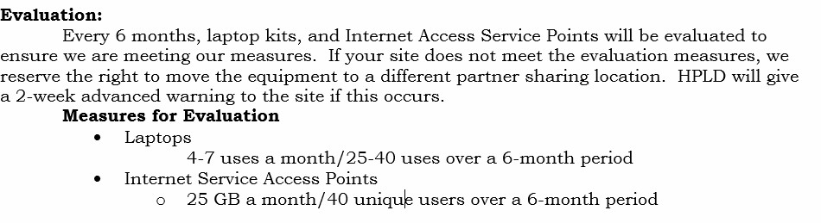

Evaluation Tools
Create a set evaluation schedule and share with partner agencies, if needed
Review and update MOUs yearly- include clear evaluation measures and schedule
Examples: Partner Sharing equipment:

Slide 14
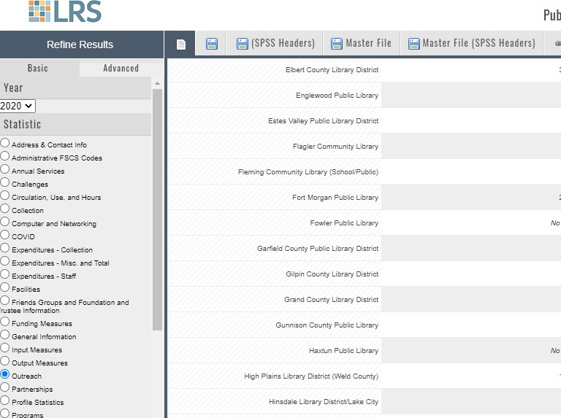
PLAR
PLAR data:
  Build tools to track this during the year: ID the data routes used to report this data at the beginning of each year
  VL open hours
MS open hours: W2W

Slide 15

Pulling and Integrating data reports.
Tied to Priority Populations and Event Types

Slide 16
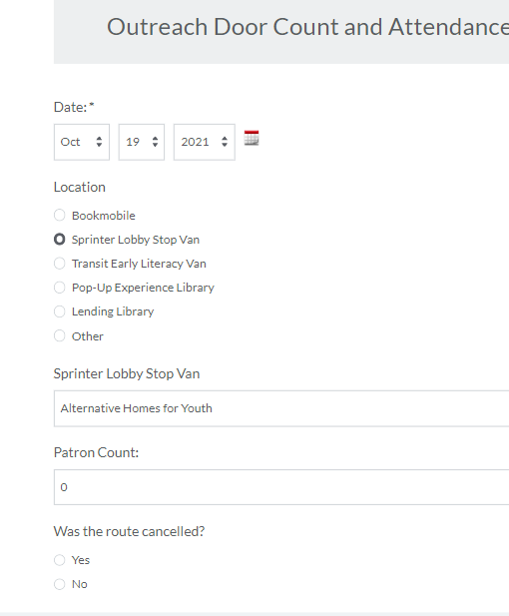
Formstack: Door counts

Slide 17
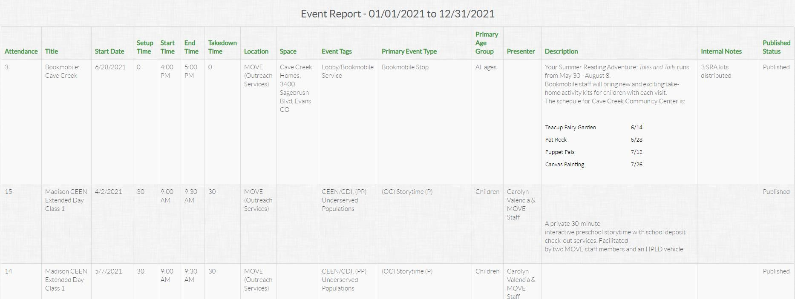
Sign Up – Event Stats

Slide 18

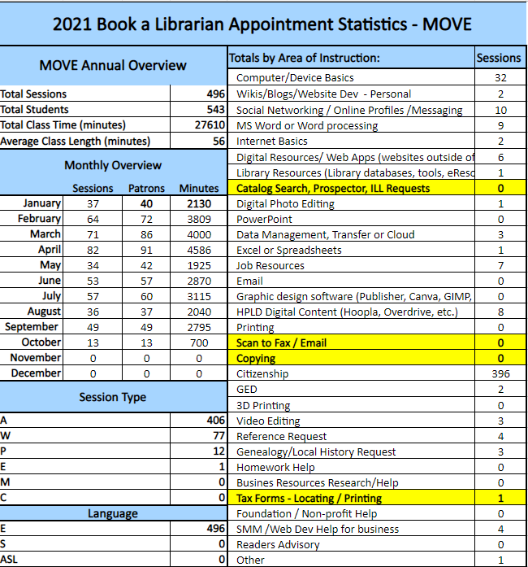
Book A Librarians

Slide 19

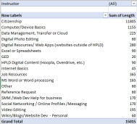
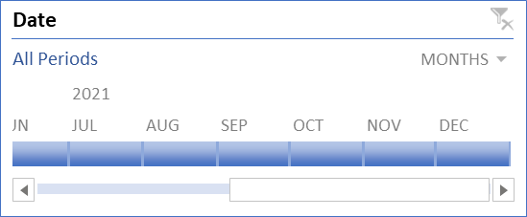
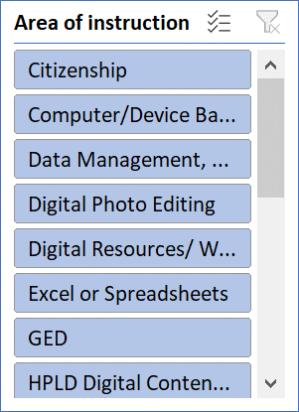
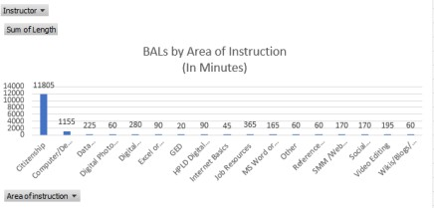

Skills in processing raw data
Creating graphs from pivot tables to visualize data
Using Splicers and Timeline Filters

Slide 20
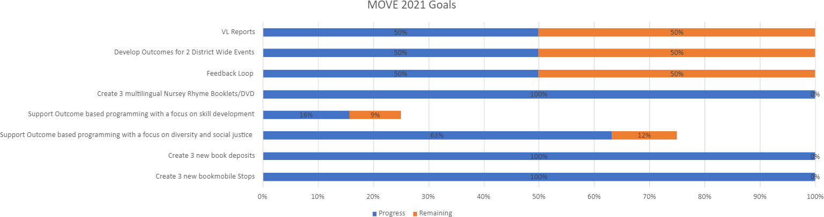
Tracking process of goal completion

Slide 21



Data Value
Understanding the value of our services to partner agencies and the gaps of understanding
Keeping staff engaged to see the progress of their work and how their work contributes to department goals
Understanding workflow of staffing for
services and events
Use as advocacy tools
Use as bases for grant funding: essential to secure Outreach resources and grow Outreach efforts

Slide 22

MOVE’s 2020 Impact Video

Slide 23

Questions?

Slide 24
Contact Us!
Megan Lowery Mobile Services Supervisor
mlowery@highplains.us
Rick Medrano Patron Services Supervisor
rmedrano@highplains.us
Brittany Raines
MOVE Manager
braines@highplains.us

Slide 25

What’s Coming Up
Outreach Advocacy, October 26th
Previously Recorded:
Outreach Foundations, September 7th
Mobile Services, September 14th Outreach Services, September 21st Virtual Services, September 28th
Events Services, Community Conversations and Feedback Loop, October 5th
Community Partnerships, October 12th
Virtual Services, September 28th
Events Services, Community Conversations and
Feedback Loop, October 5th
Community Partnerships, October 12th
Collecting Data in Outreach and Community Assessment, October 19th
Outreach Advocacy, October 26th

